Slide 1

Topic 11:
Ppe part 3 –
Respirators
[Date of training]
Notes:
Participants log in and get settled.

Slide 2
Agenda
Introductions
Videos and Discussion
  What is a Respirator?
  What is an N95 Respirator?
  How Do I Test the Seal on my N95?
Reflection
Notes:
Facilitator Notes
Welcome the group and add a greeting to the chat box.
If this session is part of an ongoing series, you may choose to say “welcome back,” “thank you for joining us again,” etc.
Announce housekeeping notes, either orally or via chat.
If needed, provide additional notes specific to the platform you’re using (e.g., how to “raise your hand,” how to post questions).
Provide an overview of the agenda.
Adapt this section of the session as needed: for instance, you may choose to spend additional time on introductions if there are new faces or if participants do not know each other.
Sample Script
“Welcome to Project Firstline. Over the next hour, we’ll explore respirators, especially one type that’s commonly used in healthcare, the N95. Please keep your videos on, to the extent possible, and keep your microphone muted when you are not contributing to the discussion. It’s great to see you all here today!
“Today we’ll talk about the job of a respirator and about topics that are specific to N95s, including their special role in infection control in healthcare, and how to perform a user seal check.”

Slide 3
Learning Objectives
Describe one (1) job of a respirator.
Describe two (2) aspects of N95s that ensure they protect the wearer from inhaling very small particles.
Explain one (1) way to perform an N95 user seal check and why it is important.
Discuss two (2) possible actions you can take if a leak in the N95 is detected.
Notes:
Facilitator Notes
Provide an overview of the session’s learning objectives.
Sample Script
“Here is what we expect to learn today. By the end of today’s training, you will be able to describe the job of a respirator and important aspects of the N95 respirator – including one way to make sure you have a good seal when you wear one.”

Slide 4
Introductions
Please introduce yourself with:
Your name
Your role (e.g., organization, unit)
Do you regularly wear respirators on the job?
Notes:
Facilitator Notes
This question will give you a better understanding of your participants’ backgrounds, experience, and level of knowledge.
If you know that your audience is unlikely to be familiar with respirators, you may wish to preface the question with the assurance that it’s okay to answer, “I don’t know.”
Tailor your slide delivery for the virtual format and platform, and the number of participants:
You may wish to call on participants individually.
You may wish to add role- or facility-specific questions to the introductions.
If you have a large group, you may decide to skip oral introductions and use the chat.
If your group meets regularly, you may wish to skip or shorten the introductions, or use a different “icebreaker” approach.
Be sure to introduce yourself and anyone who is assisting you.
Sample Script
“Let’s take a minute to get to know each other. Please share in 30 seconds or less your name, your role, and the answer to this question: Do you regularly wear respirators on the job?”

Slide 5
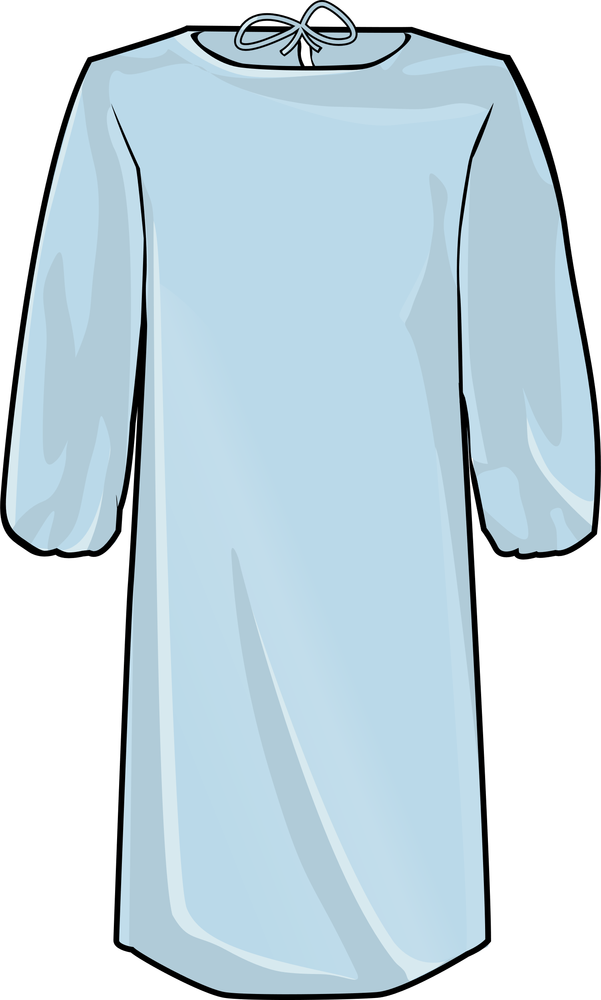
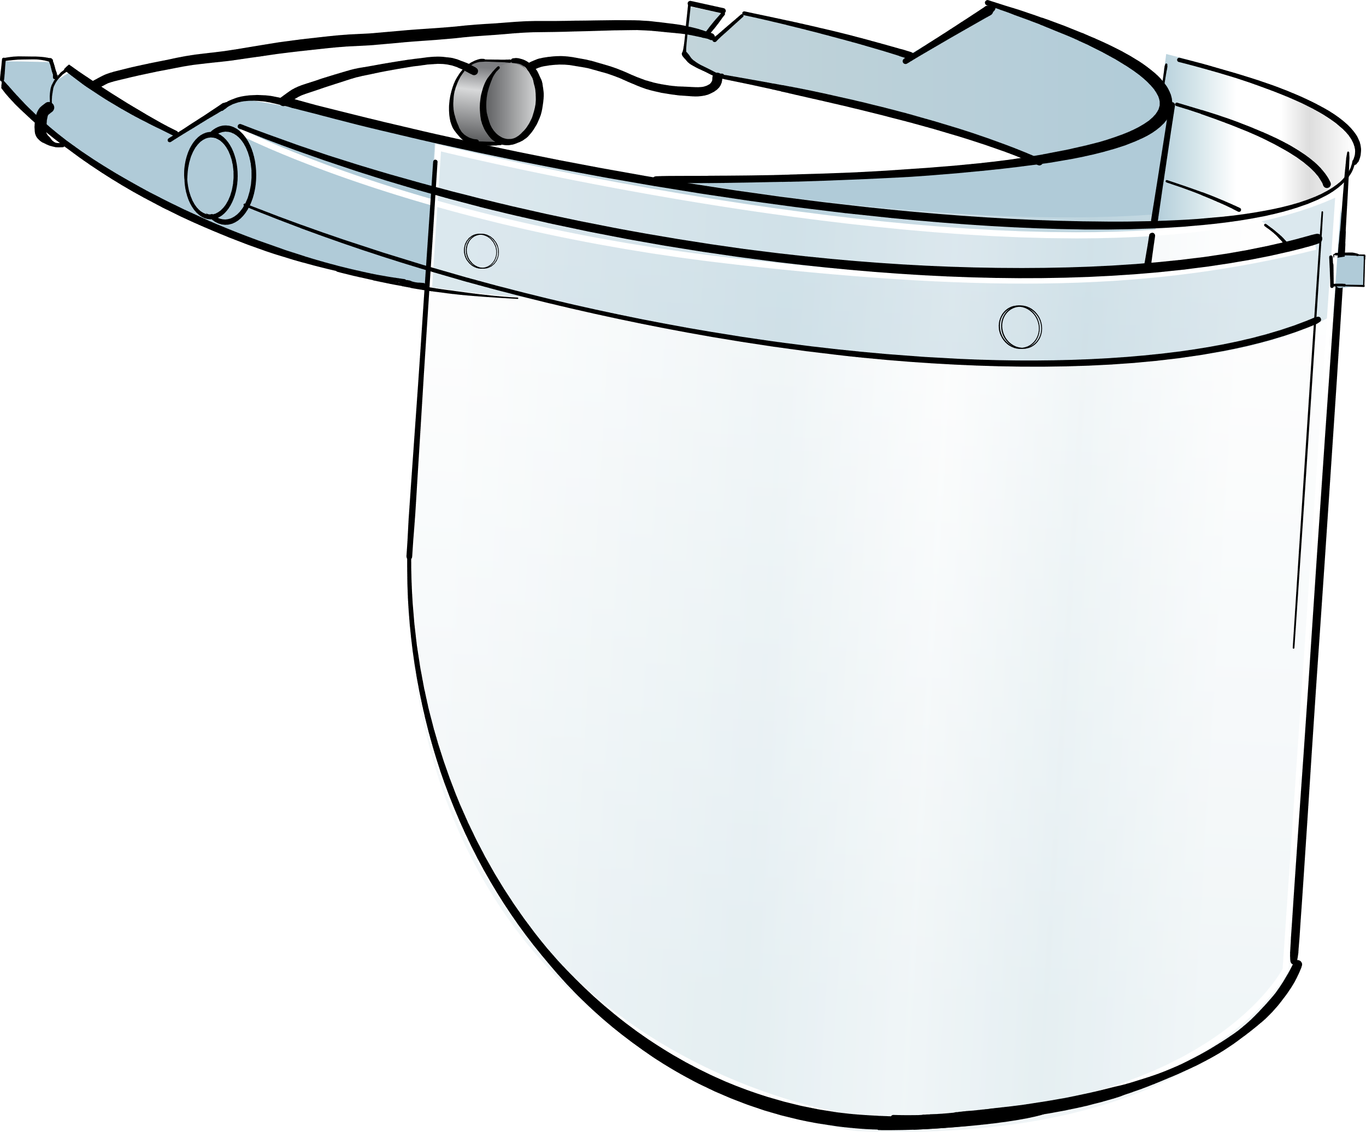

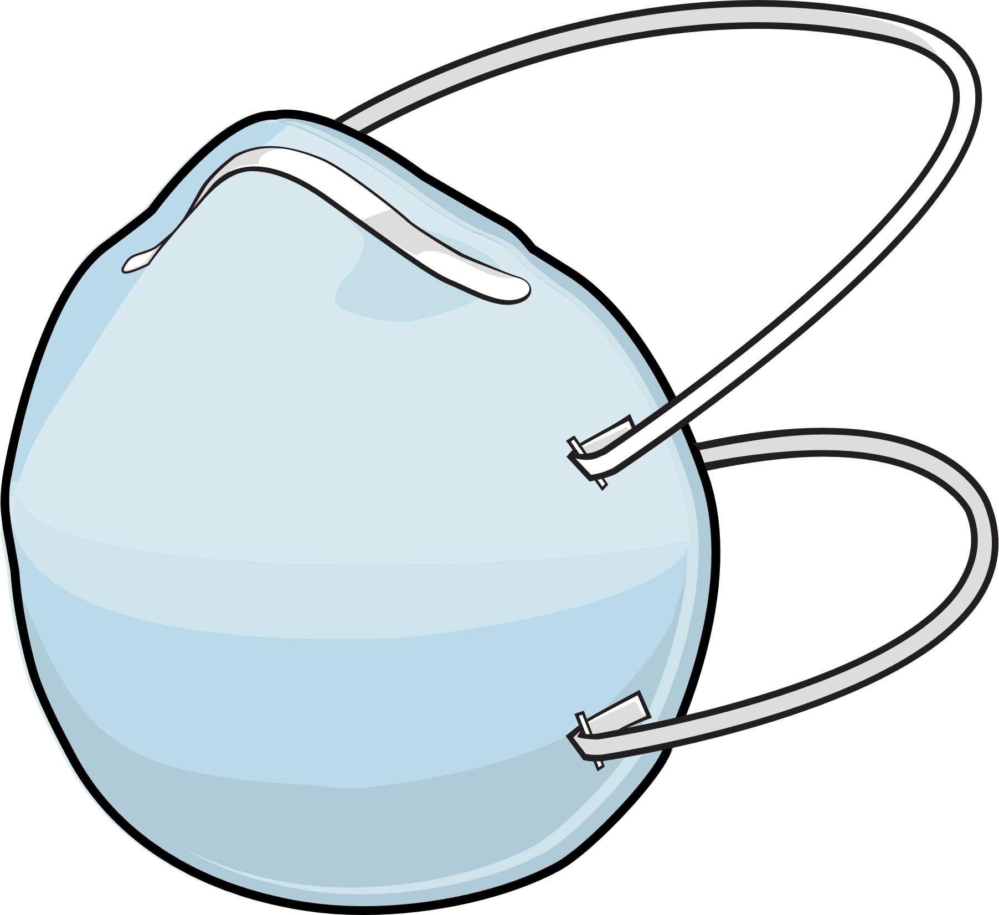

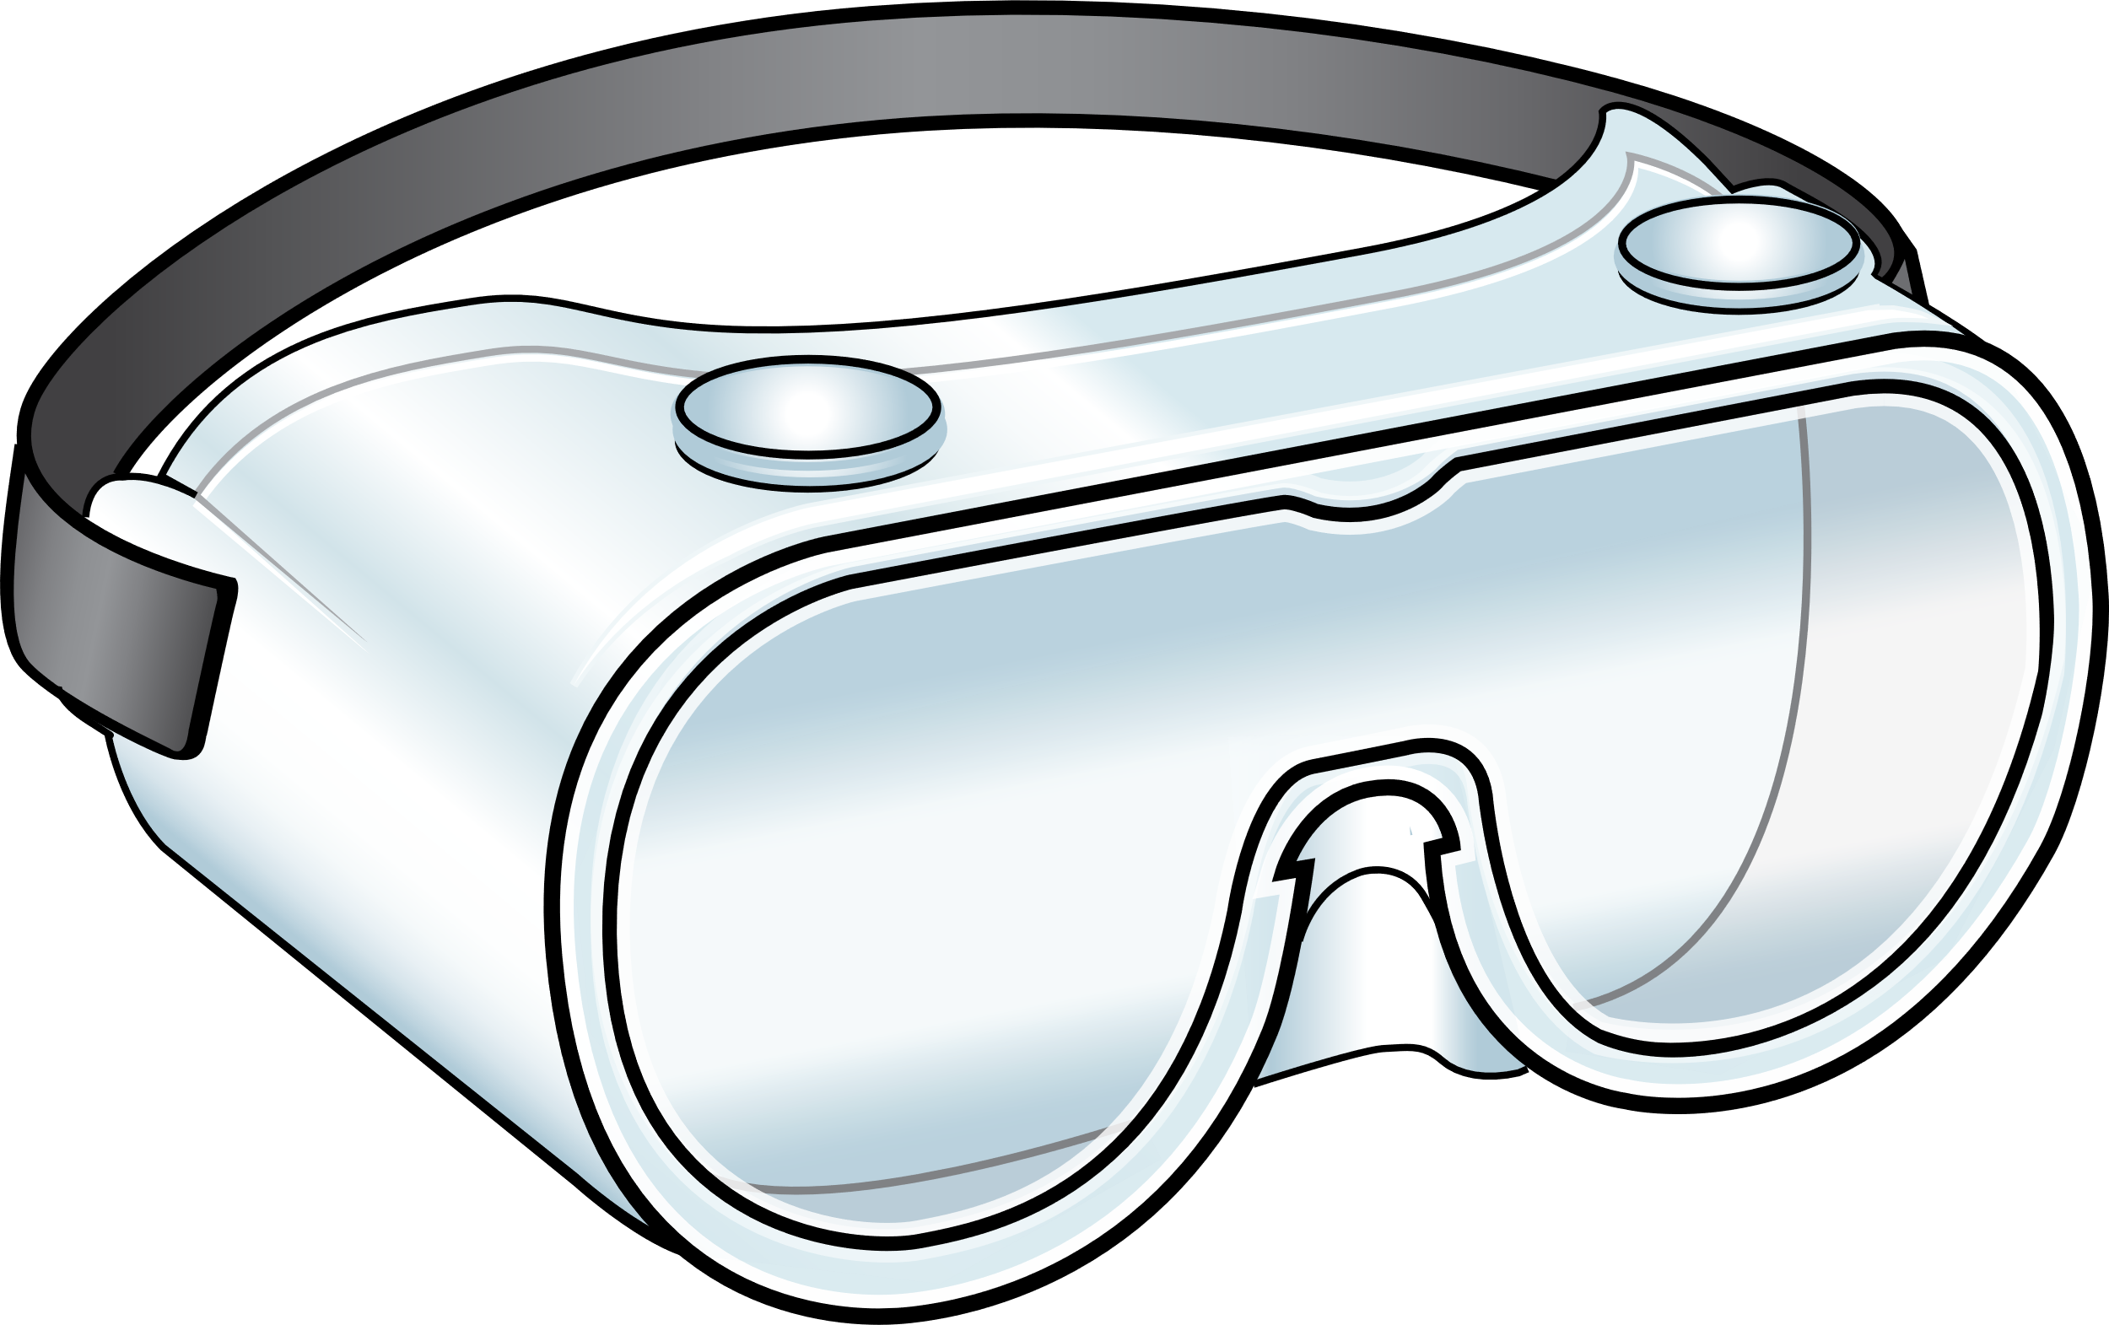
Recommended PPE for COVID-19
Eye Protection
Gloves & Gown
Respirator
Notes:
Facilitator Notes
Transition to discussion about respirators and other PPE recommended for COVID-19.
If this session is part of a series, you may choose to indicate that future sessions will focus on other pieces of PPE.
Sample Script
“Respirators are part of the recommended PPE for COVID-19. In other sessions, we’ll examine other types of PPE.”

Slide 6
How do you use respirators?
Notes:
Facilitator Notes
Based on the responses to the icebreaker question, invite volunteers to share details and describe in their own words how, and when, they use a respirator on the job.
Allow brief responses. If needed, you could prompt additional information with questions such as:
When do you wear a respirator?
What type of respirator do you use?
Depending on the experience of participants, they may be well-versed in the topic, or some may be wondering, what is a respirator anyway? Explain that they will have an opportunity to learn about respirators in this session.
You may choose for them to respond orally or via chat.
You may consider capturing their responses, either on a new slide or in the chat.
While it is not necessary for everyone to reply, be sure to solicit and affirm participant responses before moving on, and to thank participants for sharing.
Affirm that today’s session will focus on explaining the concept of a respirator and on the special role of N95s.
Sample Script
“Thank you, and welcome again! It looks like many of us use respirators on the job. Would anyone care to offer more details about how you use a respirator? Please feel free to come off mute or type in the chat."
(Pause for responses.)
“Thank you, that’s great! Today, we’re going to talk about what respirators do and the different types of respirators we might use. We’ll focus on N95s, which many of you use every day!”

Slide 7
Respirators
While watching the video, jot down:
A simple definition of a respirator
Three types of respirators commonly used in healthcare
Notes:
Facilitator Notes
Introduce the first video and explain that we will watch it to make sure everyone is on the same page.
Invite participants to make notes as they watch:
A simple definition of a respirator
Three types of respirators commonly used in healthcare
Sample Script
“Let’s start with the basics. We’ll check in with the CDC’s Dr. Abby Carlson to make sure we’re all on the same page as we answer the question, what is a respirator anyway? As you watch, please make note of a simple definition of a respirator and three types of respirators commonly used in healthcare. Please jot down your thoughts in your Participant Booklet.”

Slide 8
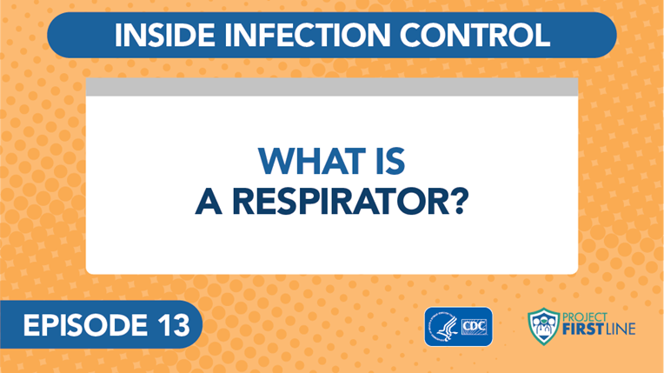
Inside Infection Control: What is a Respirator? Episode 13
Notes:
Facilitator Notes
Access the video here:
CDC Website: https://www.cdc.gov/infectioncontrol/projectfirstline/videos/EP13-Respirator-LowRes.mp4
OR
Project Firstline YouTube Playlist: https://www.youtube.com/watch?v=Cwf9tM8Tguk&list=PLvrp9iOILTQZQGtDnSDGViKDdRtIc13VX&index=14

Slide 9
What did you learn about respirators?
Notes:
Facilitator Notes
Invite participants to review the notes they wrote down during the video and share, either orally or in the chat, a simple definition of a respirator and three types of respirators commonly used in healthcare.
Acknowledge responses. Answers may include:
A respirator’s job is to keep you from breathing in things in the air that might hurt you, like germs, dust, chemicals, and other dangerous things.
In healthcare, we use respirators when we think we’re going to be in a situation when we could breathe in air that’s carrying infectious material – like particles containing viruses.
Types of respirators used in healthcare:
Filtering facepiece respirator (FFR), the type most commonly used in healthcare
Powered air-purifying respirator (PAPR)
Elastomeric respirator
You may wish to refer to the Content Outline for Episode 13 of Inside Infection Control for additional discussion points.
Sample Script
“Take a moment to review the notes you took during the video. How would you define a respirator? What are some respirators that are used in healthcare?”
(Pause for responses.)
“That’s great, thank you!”

Slide 10
What do you want to know more about?
Notes:
Facilitator Notes
Invite participants to share additional questions that they have about respirators in healthcare.
You may choose for participants to respond orally or in the chat.
You may choose to summarize key points on a slide or in the chat.
Link the questions to the next vlog episodes and discussion.
Sample Script
“I’ll pause here to ask, after that introduction to respirators, what else would you like to know about respirators in healthcare?”
(Pause for responses.)
“Thank you! Our next activity focuses on a few of these topics, so let’s get to it!”

Slide 11
More about n95S
Notes:
Facilitator Notes
Transition to small-group breakouts and discussion of N95s.
You may wish to refer to earlier discussion and note whether participants specifically mentioned using N95s on the job.
Sample Script
“We started by learning about respirators and how they keep you from breathing in infectious particles. Now, let’s dig a little deeper into the N95, which some of you mentioned is the respirator that you use on the job. We’ll break into two groups.”

Slide 12
Breakout groups
Group 1: What is an N95 Respirator?
Group 2: How Do I Test the Seal on my N95?
Instructions:
Watch the assigned video in your groups
Discuss these questions:
  What are the important points from this video? How would I explain it to others?
  Why should I care? What’s the relevance to my work?
Identify a spokesperson to share your findings with the group when we reconvene
Notes:
Facilitator Notes
Use breakout rooms appropriate to your virtual platform to divide participants into two groups.
As needed, provide instructions related to the breakout room format, such as how to ask questions.
Plan to have the hyperlinks to the videos ready to share with participants in the chat.
Explain that one group will watch Episode 14, What is an N95 Respirator?
Access the video here:
CDC website: https://www.cdc.gov/infectioncontrol/projectfirstline/videos/EP14-N95-LowRes.mp4
OR
Project Firstline YouTube Playlist: https://www.youtube.com/watch?v=_0koFmL-h9E&list=PLvrp9iOILTQZQGtDnSDGViKDdRtIc13VX&index=15
Explain that the other group will watch Episode 15, How Do I Test the Seal on my N95?
Access the video here:
CDC website: https://www.cdc.gov/infectioncontrol/projectfirstline/videos/Ep15-Seal-LoRes.mp4
OR
Project Firstline YouTube Playlist: https://www.youtube.com/watch?v=bQ8zZ31LLOw&list=PLvrp9iOILTQZQGtDnSDGViKDdRtIc13VX&index=16
Each group will then discuss the questions on the slide:
What are the important points from this video? How would I explain it to others?
Why should I care? What’s the relevance to my work?
Inform the groups that they have 15 minutes to work together.
Ask each group to identify a spokesperson who will share the group’s ideas when everyone reconvenes.
After the small groups have gathered, depending on your virtual platform, you may use the broadcast message feature or another means to send reminders of the questions, how much time is remaining, etc. You may also choose to “visit” each group to encourage conversation and to hear their thoughts.
Sample Script
“Group 1 will watch Episode 14 of Inside Infection Control: ‘What is an N95 Respirator?’ Group 2 will watch Episode 15, ‘How Do I Test the Seal on my N95?’ The first video focuses on why N95s work, and the second on why it’s important to test the seal on your N95 every time you wear it and how to do a user seal check.
“After you watch the video together, take a few minutes to discuss these questions: What are the important points from this video? How would I explain it to others? and Why should I care? What’s the relevance to my work?
“You’ll have about 15 minutes to work, and then we’ll come back together as a large group to share our ideas. Please decide on one person from your group to report out your thoughts. I’ll give you a warning when you have two minutes left.”

Slide 13
report out
Group 1:
What is an N95 respirator?
Group 2:
How do I test the seal on my N95?
Notes:
Facilitator Notes
After 15 minutes, reconvene the group.
In turn, invite one person from each group to share their responses to the questions.
After each group’s report, acknowledge the responses.
You may choose to capture high-level summaries of their responses on a slide or in the chat.
You may wish to refer to the Content Outlines for Episodes 14 and 15 of Inside Infection Control for additional discussion points and to connect their discussion to the learning objectives for this session:
Describe one (1) job of a respirator.
Describe two (2) aspects of N95s that ensure they protect the wearer from inhaling very small particles.
Explain one (1) way to perform a user seal check and why it is important.
Discuss two (2) possible actions you can take if a leak in the N95 is detected.
After the reports, lead a group discussion of strategies that they could employ to explain these concepts to others.
You may choose for participants to respond orally or in the chat.
You may choose to summarize the group’s ideas on a slide or in the chat.
Encourage participants to think about how they can use their knowledge about respirators at work, and how they can share that knowledge with others.
If appropriate to your audience, you may consider building on the suggested strategies and asking the group to reflect on any new ideas that might be helpful in their daily work.
Sample Script
“Welcome back. I’d like for each group to report on your discussion, and I’ll capture some high-level points as you share. Group 1, let’s start with you!”
(Acknowledge and react to their reports.)
“Great. Thank you for sharing your ideas! When you’re on the job in healthcare, it’s important to understand how your respirator works and to make sure it’s working correctly so it can do its job of keeping you from breathing in germs.
“Now let’s think about how you can use what you know about respirators at work, and how you can share your knowledge with others. Does anyone have any ideas?”
(Pause for responses.)
“Thanks for the good ideas!”

Slide 14
Reflection
Notes:
Facilitator Notes
Thank participants for the discussion.
If this session is part of a series, you may wish to remind the group of key points from other sessions.
Invite participants to reflect on what they learned during the session.
Sample Script
“You all did a great job of sharing your observations and coming up with useful, good strategies for sharing your knowledge. Remember, if you’re ever unsure about what to do, such as how to do a user seal check, you can always talk with your supervisor or your colleagues.
“Let’s use our last few minutes together to reflect on what we’ve learned and think about how we can put what we’ve learned into practice.”

Slide 15
What did you learn today?
Notes:
Facilitator Notes
Invite participants to share something that they learned about respirators, how N95s keep the wearer from inhaling infectious particles, or how to do a user seal check.
You may wish to refer to the Content Outlines for Inside Infection Control Episodes 13, 14, and 15 to prompt or reinforce the discussion.
You may choose for participants to respond orally or in the chat.
Acknowledge responses and consider reading them aloud if they are in the chat.
Invite additional, remaining questions.
Encourage participants to share questions that they would like Project Firstline to address in future offerings.
As above, if the answers are information that is already included in this session, please respond.
If the questions address content that is not covered in this session, please do not attempt to answer. Instead, take note of the questions and consult with CDC resources to follow up with answers after the session.
Sample Script
“I hope you’ve learned a lot today. Before we go, I’d like for you to share with me one thing you learned about respirators, how N95s work, or how to do a user seal check on your N95. I’d also like to hear how you plan to use your knowledge in your daily work. Please feel free to come off mute or to respond in the chat.”
(Pause for responses.)

Slide 16
Questions?
Notes:
Facilitator Notes
Invite additional, remaining questions.
You may choose to ask participants to respond orally, in the chat, or both.
Encourage participants to share questions that they would like Project Firstline to address in future offerings.
As above, if the answers are information that is already included in this session, please respond.
If the questions address content that is not covered in this session, please do not attempt to answer. Instead, take note of the questions and consult with CDC resources to follow up with answers after the session.
Sample Script
“Thank you all for your time! We covered a lot today, so I’ll ask one more time: does anyone have any questions still remaining or items I can clarify about respirators and N95s? And related to that, are there questions about infection control – PPE or any other aspect of infection control in healthcare – that you would like Project Firstline to address?"
(Address questions as appropriate.)
“Thank you for sharing those questions. Project Firstline is actively collecting your questions to help inform more training resources as they’re developed. I’ve written them down, and I will get back to you with responses.”

Slide 17
Key takeaways
The job of a respirator is to keep you from breathing in things in the air that might hurt you, including germs.
N95s, a type of respirator, are designed to filter out very small particles, including droplets, in the air.
N95s work not only because of the filtering material but also because of how they fit, which ensures that all the air that you breathe in goes through the filter first and doesn’t leak around the edges.
Do a “user seal check” every time you use your N95, because it is possible to put on an N95 using the correct technique and still not have a good seal around all the edges.
Notes:
Facilitator Notes
Review key takeaways.
You may choose to revisit discussion points or questions that arose during the session.
Sample Script
“I hope this training gave you some good information about respirators and N95s, and why they are so important for infection control. I’ve captured some key takeaways here, which you can review at your leisure after the session today.”

Slide 18
Resources and Future Training sessions
Project Firstline on CDC:
https://www.cdc.gov/infection control/projectfirstline/index.html
Project Firstline on Facebook:
https://www.facebook.com/CDCProjectFirstline/
Twitter:
https://twitter.com/CDC_Firstline
YouTube:
https://www.youtube.com/playlist?list=PLvrp9iOILTQZQGtDnSDGViKDdRtIc13VX
To sign up for Project Firstline e-mails, click here: https://www.cdc.gov/infectioncontrol/projectfirstline/index.html
Notes:
Facilitator Notes
Share additional resources from Project Firstline and CDC.
Explain how participants can reach you, by the means of your choosing, and how they can reach Project Firstline.
If this session is part of a series, you may choose to describe the themes of upcoming sessions.
Sample Script
“Even though we covered a lot today, there is still much more to learn. You can keep exploring these topics on your own using the resources on this slide. You can also follow us on social media. I will stay on the line for a few minutes after our session ends and will be happy to discuss any other questions!”
(If this session is part of a series) “Next time, we will cover [insert next training topic].”

Slide 19
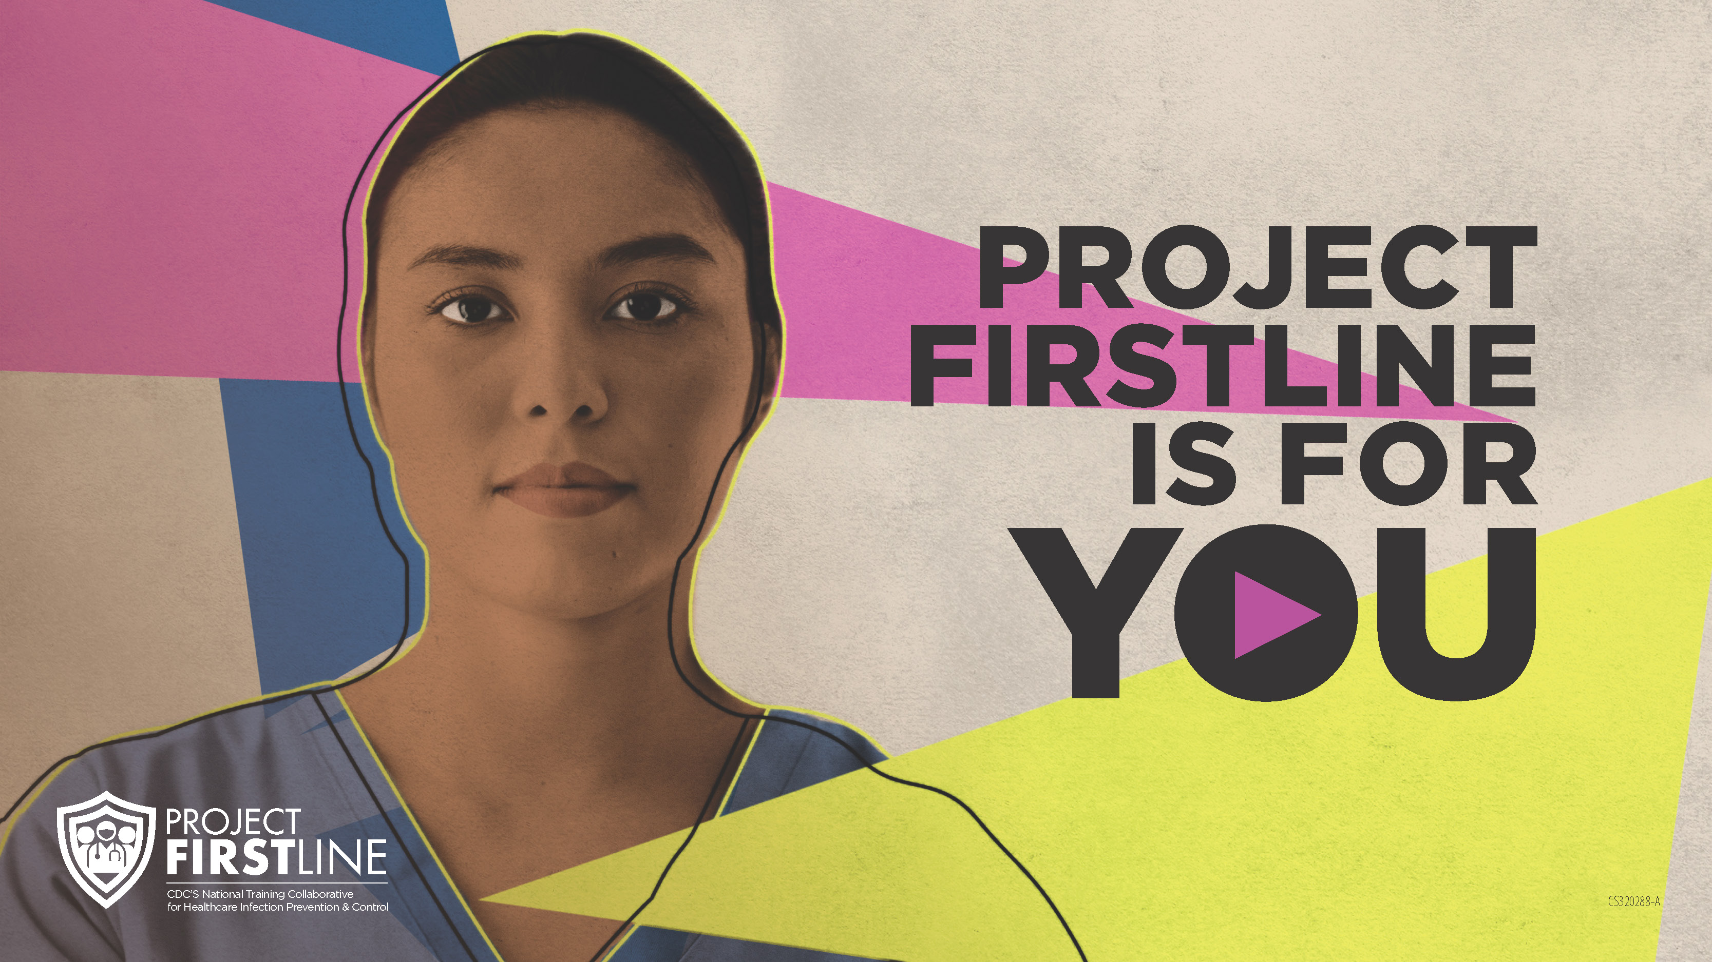
Feedback Form
Notes:
Facilitator Notes
Explain how to access the feedback form.
Sample Script
“And, finally, please let us know how you enjoyed today’s session by completing the following feedback form. Thanks again for joining us today.”
After the Session
Send list of participant questions compiled during this session to ProjectFirstline@cdc.gov.

