Slide 1
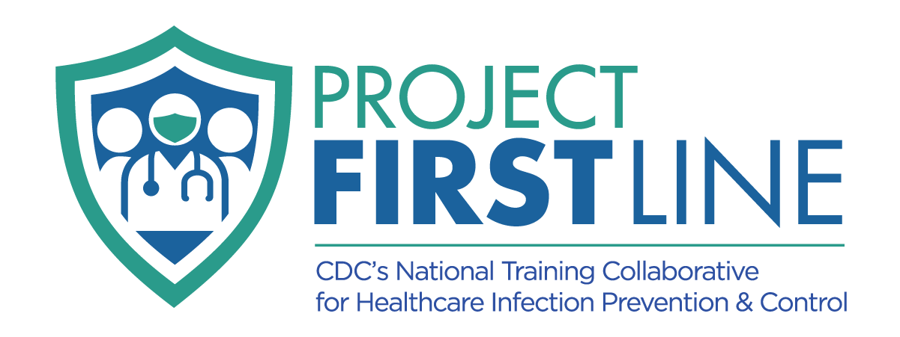
TOPIC 12:
Environmental Cleaning & Disinfection
[Date of training]
Notes:
Facilitator Notes
Participants log in and get settled.

Slide 2
Agenda
Welcome
Cleaning and Disinfection: What is the Difference?
Why Cleaning and Disinfection Matter
What is Contact Time?
Reflection
Notes:
Facilitator Notes
Welcome the group and add a greeting to the chat box.
If this session is part of an ongoing series, you may choose to say “welcome back,” “thank you for joining us again,” etc.
Announce housekeeping notes, either orally or via chat.
If needed, additional notes specific to the platform you’re using (e.g., how to “raise your hand,” how to post questions)
Provide an overview of the agenda.
Sample Script
“Welcome to Project Firstline. Thank you for joining us! Before we begin, a few housekeeping notes. We’ll meet today for 20 minutes. Please keep your videos on, to the extent possible, and keep your microphone muted when you are not contributing to the discussion. It’s great to see you all here today!
“Today we’ll focus on another essential part of infection control: cleaning and disinfection. What are they? What is the difference between them? And why do they matter?”

Slide 3
Learning OBJECTIVES
Describe the difference between cleaning and disinfection.
Discuss why it is important to follow the label instructions on a disinfectant product.
Notes:
Facilitator Notes
Provide an overview of the session’s learning objectives.
Sample Script
“Here is what we expect to learn today. By the end of today’s training, you will be able to describe the difference between cleaning and disinfection and discuss why it is important to follow the label instructions on a disinfectant product.”

Slide 4
Poll
Cleaning is killing germs. Disinfecting is removing dirt and some germs.
Disinfecting is a type of cleaning (cleaning with chemicals).
Cleaning is a type of disinfecting (disinfecting with soap or detergent).
Disinfecting is killing germs. Cleaning is removing dirt and some germs.
Notes:
Facilitator Notes
Use the poll feature for your platform to ask participants about the definitions of cleaning and disinfection.
Cleaning is killing germs. Disinfecting is removing dirt and some germs.
Disinfecting is a type of cleaning (cleaning with chemicals).
Cleaning is a type of disinfecting (disinfecting with soap or detergent).
Disinfecting is killing germs. Cleaning is removing dirt and some germs.
If the platform you are using does not have a poll feature, you may choose to ask participants to enter their responses in the chat.
Sample Script
“We clean and we disinfect a lot in healthcare, but what’s the difference? Let’s do a quick poll. Pick the sentence that best describes cleaning and disinfection.”
(Pause for participants to respond to poll options, and then display poll results.)
“Great! Thanks for doing that. The correct answer is that cleaning removes dust, dirt, and grime, including organic material like blood, and some germs. Disinfection kills germs. We’re going to learn more about cleaning and disinfection today and why they’re so important in healthcare.”

Slide 5
Cleaning and Disinfection: What’s the Difference?
Notes:
Facilitator Notes
Help participants think about moments in their daily work when they might clean or disinfect surfaces or objects.
Encourage participants to make note of their thoughts.
Sample Script
“Let’s get started.
“As we watch this episode of Inside Infection Control with the CDC’s Dr. Abby Carlson, start thinking about your workday. In your participant booklet, jot down instances when it may be important to clean, or disinfect, or both.
“Now let’s watch the video to make sure everyone is on the same page.”

Slide 6
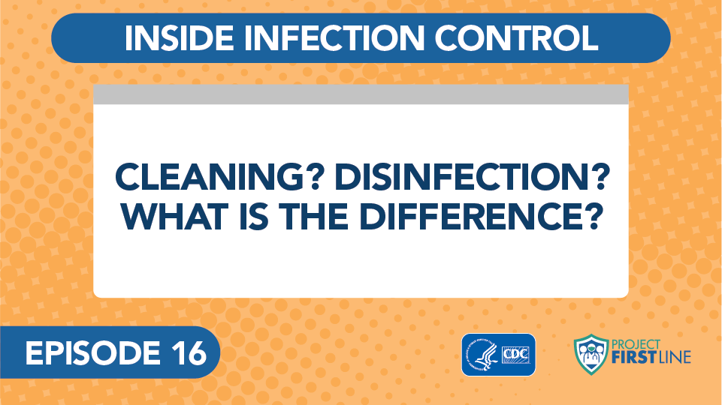
INSIDE INFECTION CONTROL, EPISODE 16: Cleaning? Disinfection? What is the Difference?
Notes:
Facilitator Notes
Access the video here:
CDC Website: https://www.cdc.gov/infectioncontrol/projectfirstline/videos/Ep16-CLEANING-LoRes.mp4
OR
Project Firstline YouTube Playlist: https://www.youtube.com/watch?v=dIuRI9OpjnY

Slide 7
Definitions
Cleaning Cleaning is a process that removes things like dust, dirt, grime, and other spills, smears, and everyday messes from surfaces, along with some germs.
Disinfection Disinfection is a process that kills germs.
Notes:
Facilitator Notes
Either allow time for participants to read the definitions themselves or read them aloud.
Sample Script
“As you heard from Dr. Carlson, cleaning removes visible dirt, dust, spills, smears, and grime, including organic material like blood, as well as some germs, from surfaces. It’s important to clean before disinfecting because dirt and grime can make disinfectants not work as well. And we need disinfectants to work to kill germs on surfaces or objects.
“Did you already know the difference between cleaning and disinfection? Or is there anything about these definitions that was new to you?”
(Acknowledge responses.)

Slide 8
Questions and Clarifications?
Notes:
Facilitator Notes
Briefly open the floor for final thoughts and any questions or areas of confusion.
If the questions address content that is not covered in this session, please do not attempt to answer. Instead, take note of the questions and consult with CDC resources to follow up with answers after the session.
Sample Script
“Great job! Before we move on, I just want to open it up in case you have any questions or things that you’d like to clarify.”

Slide 9
Why cleaning and disinfection Matter
Notes:
Facilitator Notes
The bullet points on the following slides summarize content from Episode 20 of Inside Infection Control: Why Do Cleaning and Disinfection Matter in Healthcare?: bit.ly/WhyCleanAndDis. For time reasons, the video is not shown during the 20-minute sessions.
If time allows, feel free to show the video or to share it as an extension activity.
Sample Script
“We’ve talked about the ways that cleaning and disinfection are part of our daily work life and how they work. Remember, cleaning is an important step because, if we try to disinfect something that isn’t clean, the disinfectant might not work. And we need disinfectants to kill germs. Now let’s take a few minutes to talk about why this is so important in healthcare.”

Slide 10
Patients may have weakened immune systems
In healthcare, we have patients who are ill or weak.
Why does that matter?
Germs are more likely to cause problems in these patients, because their immune defenses may not be the same as someone who is healthy and living at home.
Notes:
Facilitator Notes
This slide has animations for the second column. When you advance to the slide, only the first column will appear.
After you introduce the concept, ask participants to share, either orally or in the chat, answers to the question, “Why?”
After they provide responses, use the animation to reveal the answers.
You may wish to refer to the Content Outline for Episode 20 for additional discussion points.
Sample Script
“Cleaning and disinfection are critical in healthcare for many reasons. It’s common sense that we don’t want a dirty environment for our patients – but why is that? Does anyone have any thoughts?”
(Pause for responses, then advance to reveal second column.)
“Yes! One reason is because, in healthcare, we have patients who are ill and may not be able to fight off infections as well as someone who is healthy. Germs are more likely to cause problems in these patients because their immune defenses might not be as strong as someone who’s healthy.
“It’s possible to see how some patients might be at risk of infection, such as if they have burns or wounds, or if they’re having a procedure when germs could get into their bodies, such as getting an IV or a catheter. But many patients’ risks for infection can’t be seen, like when a patient’s immune system is weak because of the medication in their cancer treatment.”

Slide 11
The healthcare environment should be kept clean
It is important to keep the healthcare environment clean to stop germs from spreading.
Where and When?
Patient Rooms
High-touch Surfaces
  Bed rails
  Keyboards
  Light switches
Surfaces and objects that often have a lot of germs on them
  Toilet seats
Notes:
Facilitator Notes
This slide has animations for the second column. When you advance to the slide, only the first column will appear.
After you introduce the concept, ask participants to share, either by coming off mute or via chat, answers to the question, “Why?”
After they provide responses, use the animation to reveal the answers.
You may wish to refer to the Content Outline for Episode 20 for additional discussion points.
Sample Script
“It’s important to keep the healthcare environment clean to stop germs from spreading. What are some places that you can think of that need to be cleaned and disinfected often?”
(Pause for responses, then advance to reveal second column.)
“There are a lot in healthcare! Think about patient rooms. When a patient leaves a room or is discharged, before a new patient goes into that room, it should be cleaned and disinfected to make sure germs don’t spread.
“What about high-touch surfaces? We also clean and disinfect things that get touched a lot, such as bed rails, keyboards, and light switches. These ‘high-touch surfaces’ need that frequent cleaning and disinfection.
“What else? It’s also important to clean and disinfect things in healthcare that aren’t touched or shared as often but tend to be dirty and have a lot of germs on them, like toilet seats.”

Slide 12
What is contact time?
Notes:
Facilitator Notes
The bullets on the following slides summarize content from Episode 22 of Inside Infection Control: Why Does Contact Time Matter for Disinfection? bit.ly/WhyContactTime. For time reasons, the video is not shown during the 20-minute sessions.
If time allows, feel free to show the video or to share it as an extension activity.
Sample Script
“Now we’re going to take a closer look at an important part of disinfection: contact time.”

Slide 13
Definition
Contact Time
Sometimes called “dwell time,” this is the amount of time a disinfectant needs to sit on a surface, without being wiped away or disturbed, to effectively kill germs.
Notes:
Facilitator Notes
Make sure the participants are aware of what contact time is and the other terms that might be used (dwell time, wet time).
Link the concept of contact time to the reality of cleaning and disinfection at work in healthcare.
You may wish to tailor this content to your audience, as not all healthcare workers are involved in this work in the same way.
EPA List N: Disinfectants for Coronavirus (COVID-19): https://www.epa.gov/pesticide-registration/list-n-disinfectants-coronavirus-covid-19
Sample Script
“First, let’s talk about what contact time is. Does anyone have any thoughts on how to define it?”
(Pause for responses.)
“Contact time – also called ‘dwell time’ or ‘wet time’ – is the amount of time a disinfectant needs to sit on a surface, without being wiped away or disturbed, to do its job of killing germs.
“Contact time is important because the product you’re using might not kill germs right away. It takes time before all the germs are killed and something is truly ‘disinfected.’
“This time can vary depending on the product. But it is always specific, and it should be on the label. Even if you’re using a product that both cleans and disinfects, all in one, it will still have a contact time that you need to use for it to work correctly.
“Now that we know what it is, what does it mean for our daily work?”

Slide 14
The Disinfectant Label
What information do you need from a disinfectant’s label?
Is the product EPA-approved?
On which surfaces can the disinfectant be used?
What germs has the disinfectant been proven to kill?
Should the product be diluted?
What is the contact time?
Notes:
Facilitator Notes
This slide has animations. After participants provide responses, trigger the animation as you go through the script.
Invite participants to suggest the information on the label of a disinfecting product that’s important to know in order to use it correctly.
As participants respond, either by going off mute or in the chat, guide them through the information found on the product label.
Remind participants why following label instructions on disinfecting products is important.
Sample Script
“While you can usually judge if something is clean or not just by looking at it, this doesn’t work with disinfection. Because germs are too small for us to see, we can’t judge how well something has been disinfected just by looking at it. That’s why following the instructions when you use disinfecting products is so important. What information do you need from the label to make sure you’re using it correctly?”
(Pause for responses. Prompt first animation.)
“First of all, in healthcare in the United States, you’ll use disinfectants that are registered with the Environmental Protection Agency, the EPA. The EPA is charged with reviewing chemicals used for disinfection to make sure that they’re safe and effective. Disinfectants used in healthcare facilities will usually have ‘hospital-grade,’ or something similar, on the label.
(Prompt second, third, and fourth animation.)
“Other things you need to know are which surfaces the chemical can be used on, which germs the chemical has been proven to kill, and whether the product should be diluted. That means if it needs to have water or another substance added to it to bring the concentration down so it’s safe for use. If so, the label should also tell you how to do that and what to use.”
(Prompt fifth and final animation.)
“And, of course, the label will tell you the contact time – or dwell time or wet time.”

Slide 15
Dos and Don’ts for disinfection
Dos
Don’ts
Do follow the listed contact time. This ensures items are disinfected to keep germs from spreading.
Don’t rush the process. Wait until contact time is complete before using objects or surfaces or before a new patient comes into a room.
Don’t wipe the surface to dry it faster.
Don’t blow on the surface to dry it faster.
Notes:
Facilitator Notes
Because there is often pressure to move fast in healthcare, this slide is an opportunity to discuss why it is important not to rush the disinfection process.
Time permitting and if applicable, you may wish to open the floor to invite participants to share instances in their experience in which they have felt hurried.
Sample Script
“We know that we want to use disinfecting products at the right times and correctly. But what do we not want to do?
“One of the biggest ‘don’ts’ is don’t rush the process. The entire contact time has to finish before something that’s been disinfected can be used again, like shared equipment, or before a new patient comes into a room after the last patient has been discharged. That’s how we can be sure the disinfectant has had time to do its job and kill the germs.
“Don’t try to dry a surface that’s been disinfected more quickly by wiping with another cloth, or by blowing on it with your breath. Also, don’t blow air on the surface another way, like with a fan, unless the manufacturer of the product you’re using says it’s okay to.
“Be patient. We know this can be tough. Patients may be waiting for rooms and equipment, and there may be pressure to move fast. But the risk of spreading germs is too great to rush the process. Following the instructions keeps germs from spreading and keeps your patients and co-workers safe!”

Slide 16
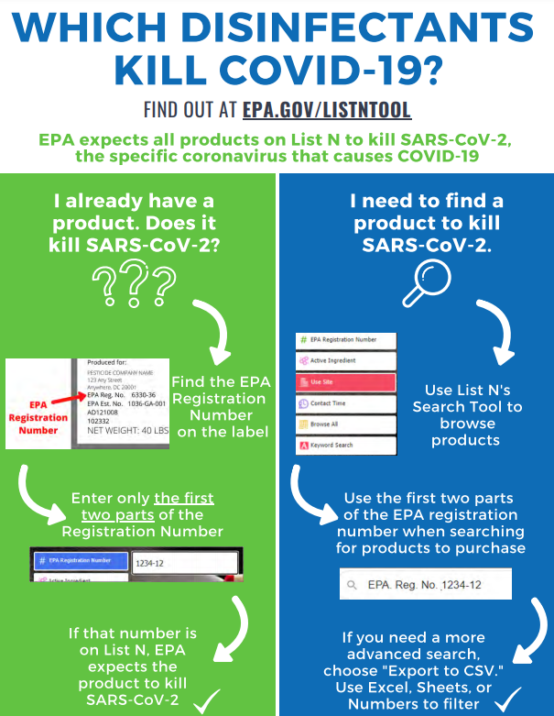
Disinfectants that kill SARS-CoV-2
EPA’s List N is a searchable database that makes it easy to find products that kill SARS-CoV-2
Notes:
Facilitator Notes
Share links in chat to EPA resources regarding disinfectants that kill SARS-CoV-2.
List N – Infographic: Which disinfectants kill COVID-19? https://www.epa.gov/sites/production/files/2020-12/documents/list_n_how-to_infographic_final_0.pdf
List N Tool: COVID-19 Disinfectants: https://cfpub.epa.gov/giwiz/disinfectants/index.cfm
About List N: Disinfectants for Coronavirus (COVID-19): https://www.epa.gov/coronavirus/about-list-n-disinfectants-coronavirus-covid-19-0
Selected EPA-Registered Disinfectants: https://www.epa.gov/pesticide-registration/selected-epa-registered-disinfectants
These links also appear on the “Resources” slide.
Sample Script
“The EPA has many resources about disinfectants for use in healthcare and lists of disinfectants that are effective against different germs, including SARS-CoV-2, which is the virus that causes COVID-19. The list for SARS-CoV-2 is called ‘List N.’ We’ll put the links in the chat, and they’re also included on the ‘Resources’ slide for your reference later.”

Slide 17
Reflection:
What did you learn today?
Notes:
Facilitator Notes
Invite participants to share what they learned during the session.
Encourage participants to describe actions that they can take to use what they have learned. They may come off mute and speak, or type in the chat, or both.
As appropriate, make connections between participants’ responses and the material from the session, particularly “why” cleaning and disinfection are so important in healthcare.
Invite additional, remaining questions.
If the answers are information that is already included in this session, please respond.
If the questions address content that is not covered in this session, please do not attempt to answer. Instead, take note of the questions and consult with CDC resources to follow up with answers after the session.
Sample Script
“Let’s use our last few minutes together to reflect on what we’ve covered today and think about how we can learn more and put what we’ve learned into practice.
“I’d love to hear from you about what you learned today. Would anyone like to share?”
(Acknowledge and address responses.)
“As we just heard, you’ve learned a lot today. I’d like you to identify one thing you’ll need to do, or continue to do, in your daily work to help keep the healthcare environment clean and stop germs from spreading.”
(Acknowledge and address responses.)
“Thank you for sharing! Does anyone have any questions still remaining?”
(Address questions as appropriate.)
“Thank you for sharing those questions. Project Firstline is actively collecting your questions to help inform more training resources as they’re developed. I’ve written them down, and I will get back to you with responses.”

Slide 18
Key Takeaways
Cleaning removes visible dirt, dust, spills, smears, and grime, including organic material like blood, as well as some germs, from surfaces. It’s important to clean before disinfecting because dirt and grime can make disinfectants not work as well.
Disinfecting kill germs on surfaces or objects.
It is important to keep the healthcare environment clean to stop the spread of germs.
Follow the instructions on the disinfectant label – especially instructions for contact time.
Notes:
Facilitator Notes
Review key takeaways.
You may choose to revisit discussion points or questions that arose during the session.
Sample Script
“I hope this training gave you some good information about cleaning and disinfection and why it’s so important to do them correctly in healthcare. I’ve captured some key takeaways here, which you can review at your leisure after the session today.”

Slide 19
Resources and Future Training sessions
Project Firstline Resources
Other Resources
Project Firstline on CDC:
https://www.cdc.gov/infection control/projectfirstline/index.html
Project Firstline on Facebook:
https://www.facebook.com/CDCProjectFirstline/
Twitter:
https://twitter.com/CDC_Firstline
Youtube:
https://www.youtube.com/playlist?list=PLvrp9iOILTQZQGtDnSDGViKDdRtIc13VX
To sign up for Project Firstline e-mails, click here: https://tools.cdc.gov/campaignproxyservice/subscriptions.aspx?topic_id=USCDC_2104
CDC’s Environmental Cleaning Evaluation Tools: https://www.cdc.gov/hai/prevent/prevention_tools.html#anchor_1561577385
CDC’s Reduce Risk from Surfaces: https://www.cdc.gov/hai/prevent/environment/surfaces.html
EPA’s Six Steps for Safe & Effective Disinfectant Use:
https://www.epa.gov/sites/production/files/2020-04/documents/disinfectants-onepager.pdf
EPA’s List N Tool:
https://cfpub.epa.gov/giwiz/disinfectants/index.cfm
About List N: Disinfectants for Coronavirus (COVID-19): https://www.epa.gov/coronavirus/about-list-n-disinfectants-coronavirus-covid-19-0
Selected EPA-Registered Disinfectants: https://www.epa.gov/pesticide-registration/selected-epa-registered-disinfectants
List N - Infographic Which disinfectants kill COVID-19?: https://www.epa.gov/sites/production/files/2020-12/documents/list_n_how-to_infographic_final_0.pdf
Environmental Cleaning & Disinfection
Notes:
Facilitator Notes
Share additional resources from Project Firstline and CDC.
If this session is part of a series, you may choose to describe the themes of upcoming sessions.
Sample Script
“That’s great, thank you. We covered a lot today, and there is still more to learn. You can keep exploring these topics on your own using the resources on this slide. You can also follow us on social media.”
(If this session is part of a series) “Next time, we will cover [insert next training topic].”

Slide 20
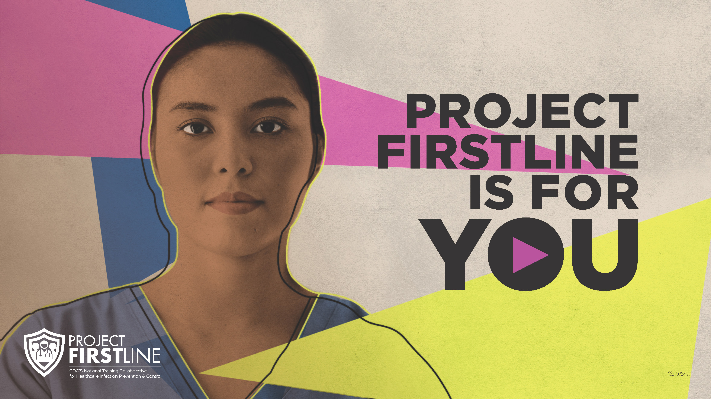
Feedback Form
Notes:
Facilitator Notes
Explain how to access the feedback form.
Sample Script
“And, finally, please let us know how you enjoyed today’s session by completing the following feedback form. Thanks again for joining us today.”
After the Session
Send list of participant questions compiled during this session to ProjectFirstline@cdc.gov.

