Slide 1

Topic 11:
Ppe part 3 –
N95 user seal check
[Date of training]
Notes:
Participants log in and get settled.

Slide 2
Agenda
Welcome
N95 User Seal Check
Reflection
Notes:
Facilitator Notes
Welcome the group and add a greeting to the chat box.
If this session is part of an ongoing series, you may choose to say “welcome back,” “thank you for joining us again,” etc.
Announce housekeeping notes, either orally or via chat.
If needed, provide additional notes specific to the platform you’re using (e.g., how to “raise your hand,” how to post questions).
Provide an overview of the agenda.
Adapt this section of the session as needed: for instance, you may choose to spend additional time on introductions if there are new faces or if participants do not know each other.
Sample Script
“Welcome to Project Firstline. Over the next 10 minutes, we’ll explore user seal checks for N95 respirators. Please keep your videos on, to the extent possible, and keep your microphone muted when you are not contributing to the discussion. It’s great to see you all here today!”

Slide 3
Learning Objectives
Explain one (1) way to perform an N95 user seal check and why it is important.
Discuss two (2) possible actions you can take if a leak in the N95 is detected.
Notes:
Facilitator Notes
Provide an overview of the session’s learning objectives.
Sample Script
“Here is what we expect to learn today. By the end of today’s training, you will be able to describe how to make sure you have a good seal when you wear an N95 and why a user seal check is important.”

Slide 4
N95 user seal check
A “user seal check” makes sure you have a good seal every time you use your N95 so that all the air you’re breathing in passes through the filtering material and doesn’t leak in around the edges.
Do a user seal check every time you use your N95, because it is possible to put on an N95 using the correct technique and still not have a good seal around the edges.
Most of the time, the best way to check the seal is with a “positive pressure” check: gently breathe out while blocking the paths where air might escape to make sure there aren’t any leaks around your face or in the filter itself.
Notes:
Facilitator Notes:
Invite group discussion of what a user seal check is and why it’s important.
The bullet points on slides 4 and 5 summarize content from Episode 15 of Inside Infection Control: How Do I Test the Seal on my N95? For time reasons, the video is not shown during the 10-minute session. You may wish to refer to the Content Outline for Episode 15 for additional discussion points.
Sample Script:
“Does anyone know why it’s important to do something called a ‘user seal check’ every time you put on your N95?”
(Pause for responses.)
“That’s right. You want to make sure you have a good seal around all the edges when you put on your N95, because it’s possible to put it on using the correct technique and still not have that good seal. This makes sure that all the air you’re breathing in goes through the filter first and doesn’t leak in around the edges. If there’s a leak or bad seal, then it’s likely you’ll breathe in unfiltered air, which could have germs in it. How do we perform a user seal check?”
(Pause for responses.)
“It’s important to follow the instructions on how to do a user seal check that came from the manufacturer of your specific type of N95. Most of the time, the best way to check the seal is with a ‘positive pressure’ check: gently breathe out while blocking the paths where air might escape to make sure there aren’t any leaks around your face or in the filter itself.”

Slide 5
Checking for leaks
What if you detect a leak in your N95?
Use both hands to mold the metal nose strip to the bridge of your nose, starting from the top.
Readjust the straps at the top and base of your head.
If there is still a leak, you may need a new N95, a different size or model of N95, or a different type of respirator.
Notes:
Facilitator Notes:
Invite group discussion of strategies they can use if they find a leak in their N95.
The bullet points on slides 4 and 5 summarize content from Episode 15 of Inside Infection Control: How Do I Test the Seal on my N95? For time reasons, the video is not shown during the 10-minute session. You may wish to refer to the Content Outline for Episode 15 for additional discussion points.
This slide has animations for the bullets. When you advance to the slide, only the blue text will appear.
After you introduce the points, ask participants to share answers to the questions “Why?” or “How?” either orally or in the chat.
After they provide responses, use the animation to reveal the answers.
Sample Script:
“What are some actions you can take if you detect a leak in your N95?”
(Pause for responses.)
“Great, thanks for your responses. If the pressure doesn’t build up, or there is a leak, you can use both of your hands to mold the metal nose strip to the bridge of your nose, starting from the top. You can also move the straps to different areas at the top and base of your head to get the best possible fit.
“If there’s still a leak, you may need to be fit-tested with a different model of N95 or a different size. It’s also possible the N95 may be worn out and you need a new one, or you may need a different type of respirator.”

Slide 6
Reflection
Notes:
Facilitator Notes
Thank participants for the discussion.
If this session is part of a series, you may wish to remind the group of key points from other sessions.
Invite participants to reflect on what they learned during the session.
Sample Script
“You all did a great job of sharing your observations. Remember, if you’re ever unsure about what to do, such as how to do a user seal check, you can always talk with your supervisor or your colleagues.
“Let’s use our last few minutes together to reflect on what we’ve learned and think about how we can put what we’ve learned into practice.”

Slide 7
Questions?
Notes:
Facilitator Notes
Invite additional, remaining questions.
You may choose to ask participants to respond orally, in the chat, or both.
If the answers are information that is already included in this session, please respond.
If the questions address content that is not covered in this session, please do not attempt to answer. Instead, take note of the questions and consult with CDC resources to follow up with answers after the session.
Sample Script
“Are there any unanswered questions or items I can clarify about how to check the seal on your N95?”
(Pause for responses.)
“Thank you for sharing those questions. I’ve written them down, and I will get back to you with responses.”

Slide 8
Key takeaways
Do a “user seal check” every time you use your N95, because it is possible to put on an N95 using the correct technique and still not have a good seal around all the edges.
If there’s a leak or bad seal, then it’s likely you’ll breathe in unfiltered air, which could have germs in it, from around the sides of the N95.
Most of the time, the best way to check your seal is with a “positive pressure” check.
Notes:
Facilitator Notes
Review key takeaways.
You may choose to revisit discussion points or questions that arose during the session.
Sample Script
“I hope this training gave you some good information about user seal checks for your N95s and why those checks are so important. I’ve captured some key takeaways here, which you can review at your leisure after the session today.”

Slide 9
Resources and Future Training sessions
Project Firstline on CDC:
https://www.cdc.gov/infection control/projectfirstline/index.html
Project Firstline on Facebook:
https://www.facebook.com/CDCProjectFirstline/
Twitter:
https://twitter.com/CDC_Firstline
YouTube:
https://www.youtube.com/playlist?list=PLvrp9iOILTQZQGtDnSDGViKDdRtIc13VX
To sign up for Project Firstline e-mails, click here: https://www.cdc.gov/infectioncontrol/projectfirstline/index.html
Notes:
Facilitator Notes
Share additional resources from Project Firstline and CDC.
Explain how participants can reach you, by the means of your choosing, and how they can reach Project Firstline.
If this session is part of a series, you may choose to describe the themes of upcoming sessions.
Sample Script
“Even though we covered a lot today, there is still much more to learn. You can keep exploring these topics on your own using the resources on this slide. You can also follow us on social media. I will stay on the line for a few minutes after our session ends and will be happy to discuss any other questions!”
(If this session is part of a series) “Next time, we will cover [insert next training topic].”

Slide 10
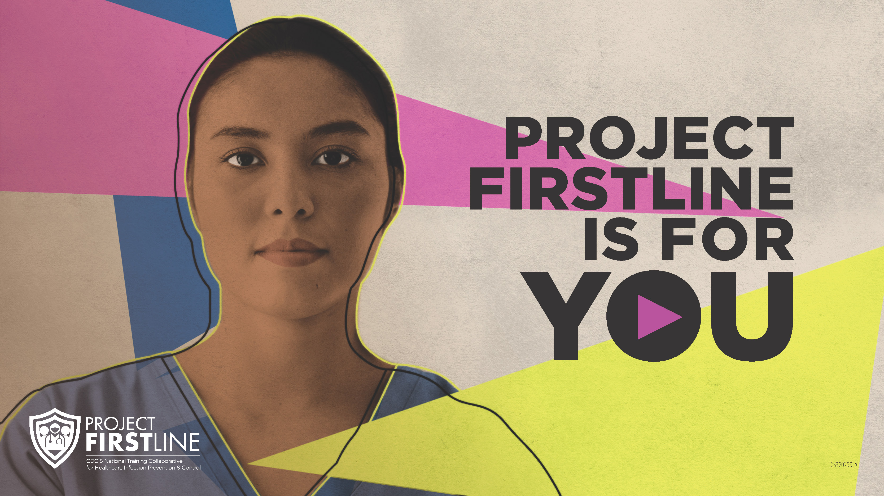
Feedback Form
Notes:
Facilitator Notes
Explain how to access the feedback form.
Sample Script
“And, finally, please let us know how you enjoyed today’s session by completing the following feedback form. Thanks again for joining us today.”
After the Session
Send list of participant questions compiled during this session to ProjectFirstline@cdc.gov.

