Slide 1

Topic 11:
Ppe part 3 –
Respirators and N95s
[Date of training]
Notes:
Participants log in and get settled.

Slide 2
Agenda
Welcome
Discussion
  What is a Respirator?
  What is an N95 Respirator?
Reflection
Notes:
Facilitator Notes
Welcome the group and add a greeting to the chat box.
If this session is part of an ongoing series, you may choose to say “welcome back,” “thank you for joining us again,” etc.
Announce housekeeping notes, either orally or via chat.
If needed, provide additional notes specific to the platform you’re using (e.g., how to “raise your hand,” how to post questions).
Provide an overview of the agenda.
Adapt this section of the session as needed: for instance, you may choose to spend additional time on introductions if there are new faces or if participants do not know each other.
Sample Script
“Welcome to Project Firstline. Over the next 10 minutes, we’ll explore respirators, especially one type that’s commonly used in healthcare, the N95. Please keep your videos on, to the extent possible, and keep your microphone muted when you are not contributing to the discussion. It’s great to see you all here today!”

Slide 3
Learning Objectives
Describe one (1) job of a respirator.
Describe two (2) aspects of N95s that ensure they protect the wearer from inhaling very small particles.
Notes:
Facilitator Notes
Provide an overview of the session’s learning objectives.
Sample Script
“Here is what we expect to learn today. By the end of today’s training, you will be able to describe the job of a respirator and important aspects of the N95 respirator.”

Slide 4
What is a respirator?
A respirator keeps you from breathing in things in the air that might hurt you, like germs.
In healthcare, we use respirators when we think we’re going to be in a situation when we could breathe in air that’s carrying infectious material.
Types of respirators used in healthcare:
  Filtering facepiece respirator (FFR)
  Powered air-purifying respirator (PAPR)
  Elastomeric respirator
Notes:
Facilitator Notes:
Invite group discussion about the job of a respirator, and how they use respirators on the job.
The bullet points on slide 4 summarize content from Episode 13 of Inside Infection Control: What is a Respirator? For time reasons, the video is not shown during the 10-minute session. You may wish to refer to the Content Outline for Episode 13 for additional discussion points.
This slide has animations for the bullets. When you advance to the slide, only the blue text will appear.
After you introduce the points, ask participants to share answers to the questions “Why?” or “How?” either orally or in the chat.
After they provide responses, use the animation to reveal the answers.
Invite participants to share, either orally or in the chat, a simple definition of a respirator and three types of respirators commonly used in healthcare.
Sample Script
“Can someone share how they would define a respirator? What are some respirators that are used in healthcare?”
(Pause for responses.)
“Thanks for sharing. A respirator’s job is to keep you from breathing in things in the air that might hurt you, like germs, dust, chemicals, and other dangerous things. In healthcare, we use respirators when we think we’re going to be in a situation when we could breathe in air that’s carrying infectious material – like particles containing viruses. There are different types of respirators available, but the type that we use most commonly in healthcare is the filtering facepiece respirator, or FFR. You may also see the powered air-purifying respirator, or PAPR [pronounced ‘papp-per’], and the elastomeric respirator.”

Slide 5
What is an n95 Respirator?
“N95” is a term used for certain respirators tested and approved for use in healthcare by the National Institute for Occupational Safety and Health (NIOSH).
N95s are designed to filter out
certain sizes of very small particles
in the air, including droplets, before
the air reaches your mouth, nose,
and lungs.
Most N95s are also good at blocking
your respiratory droplets from
spreading to others, including any
germs that you are breathing out.
How?
N95s are made of a special filtering material that filters out at least 95% of very small particles in the air.
N95s fit snugly and ensure the air you’re breathing in goes through the filter first and doesn’t leak in around the edges.
Notes:
Facilitator Notes:
The bullet points on slide 5 summarize content from Episode 14 of Inside Infection Control: What is an N95? For time reasons, the video is not shown during the 10-minute session. You may wish to refer to the Content Outline for Episode 14 for additional discussion points.
This slide has animations for the second column. When you advance to the slide, only the first column will appear.
After you introduce the points, ask participants to share answers to the questions “Why?” or “How?” either orally or in the chat.
After they provide responses, use the animation to reveal the answers.
Sample Script:
“Does anyone know what an N95 is?”
(Pause for responses.)
“That’s right. It’s a type of respirator that’s been tested and approved by NIOSH for use in healthcare. Let’s talk about why N95s are important for infection control in healthcare. First, N95s are designed to filter out certain sizes of very small particles in the air. They also block your respiratory droplets from spreading to the environment. How do they do that?”
(Pause for responses.)
“Yes! N95s are made of a special filtering material that filters out at least 95% of very small particles in the air. N95s work not only because of the filtering material but also because of how they fit. They’re put together in a way that makes sure all the air you’re breathing in goes through the filter first and doesn’t leak in around the edges. In order to work correctly, your N95 must fit your face well. So, when it comes to N95s, there are two big things to remember about how they protect you: filter and fit.”

Slide 6
Reflection
Notes:
Facilitator Notes
Thank participants for the discussion.
If this session is part of a series, you may wish to remind the group of key points from other sessions.
Invite participants to reflect on what they learned during the session.
Sample Script
“You all did a great job of sharing your observations! Let’s use our last few minutes together to reflect on what we’ve learned and think about how we can put what we’ve learned into practice.”

Slide 7
Questions?
Notes:
Facilitator Notes
Invite additional, remaining questions.
You may choose to ask participants to respond orally, in the chat, or both.
If the answers are information that is already included in this session, please respond.
If the questions address content that is not covered in this session, please do not attempt to answer. Instead, take note of the questions and consult with CDC resources to follow up with answers after the session.
Sample Script
“Are there any unanswered questions or items I can clarify about respirators and N95s?”
(Pause for responses.)
“Thank you for sharing those questions. I’ve written them down, and I will get back to you with responses.”

Slide 8
Key takeaways
The job of a respirator is to keep you from breathing in things in the air that might hurt you, including germs.
N95s, a type of respirator, are designed to filter out very small particles, including droplets, in the air.
N95s work not only because of the filtering material but also because of how they fit, which ensures that all the air that you breathe in goes through the filter first and doesn’t leak in around the edges.
Notes:
Facilitator Notes
Review key takeaways.
You may choose to revisit discussion points or questions that arose during the session.
Sample Script
“I hope this training gave you some good information about respirators and N95s, and why they are so important for infection control. I’ve captured some key takeaways here, which you can review at your leisure after the session today.”

Slide 9
Resources and Future Training sessions
Project Firstline on CDC:
https://www.cdc.gov/infection control/projectfirstline/index.html
Project Firstline on Facebook:
https://www.facebook.com/CDCProjectFirstline/
Twitter:
https://twitter.com/CDC_Firstline
YouTube:
https://www.youtube.com/playlist?list=PLvrp9iOILTQZQGtDnSDGViKDdRtIc13VX
To sign up for Project Firstline e-mails, click here: https://www.cdc.gov/infectioncontrol/projectfirstline/index.html
Notes:
Facilitator Notes
Share additional resources from Project Firstline and CDC.
Explain how participants can reach you, by the means of your choosing, and how they can reach Project Firstline.
If this session is part of a series, you may choose to describe the themes of upcoming sessions.
Sample Script
“Even though we covered a lot today, there is still much more to learn. You can keep exploring these topics on your own using the resources on this slide. You can also follow us on social media. I will stay on the line for a few minutes after our session ends and will be happy to discuss any other questions!”
(If this session is part of a series) “Next time, we will cover [insert next training topic].”

Slide 10
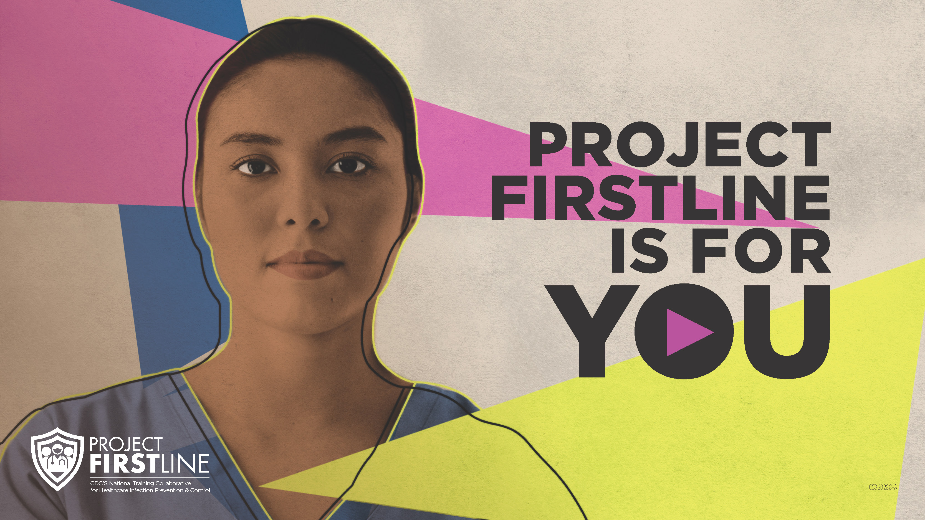
Feedback Form
Notes:
Facilitator Notes
Explain how to access the feedback form.
Sample Script
“And, finally, please let us know how you enjoyed today’s session by completing the following feedback form. Thanks again for joining us today.”
After the Session
Send list of participant questions compiled during this session to ProjectFirstline@cdc.gov.

