Slide 1

Pathway to Excellence in Long-Term Care®: Creating and Sustaining a Culture of Excellence

Slide 2
Challenges of the Current Global Health Care Landscape
New payment models and economic impact
of the global
pandemic
Changing
regulations and guidelines
Caring for population of younger residents¹ and residents with mental illness²
Decreasing supply of LTC nursing staff
¹ USDHHS, 2016; ² Grabowski et al., 2010

Slide 3



Other Disturbing Facts
30 % of LTC nurses experience burnout ³
Turnover rates estimated 45-66 %⁴
1 in 4 CNAs looking for a new job⁴
³ White et al., 2019; ⁴Boushy & Glynn, 2012

Slide 4
Disturbing Trends in Long-term Care
Nurse Shortage
Absenteeism
Burnout
Overtime
LTC facilities average 9.2% absenteeism per week leading to missed care and poor resident outcomes⁶
Expected to be a shortage of 151,000 direct care staff by 2030⁵
LTC overtime increased 60% from 2015-2018⁷
LTC nurses have higher levels of burnout than in any other setting⁸
Figure adaptation²⁰
⁵Salela 2017, ⁶Castle & Ferguson-Rome, 2014; ⁷ Ross, 2018; ⁸ White et al., 2020

Slide 5
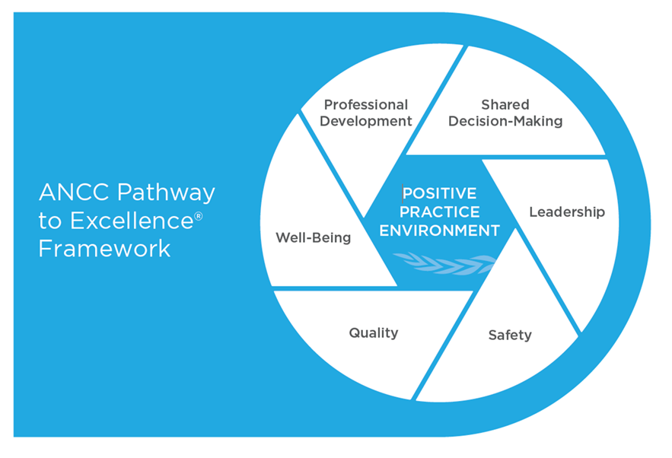
Pathway to Excellence Framework for Positive Practice Environments™
Empowers, engages, and gives front-line staff a voice
Fosters staff participation in improving outcomes
Creates a culture of sustained excellence
Strengthens interprofessional collaboration
Safeguards workforce well-being
ANCC Pathway to Excellence® Framework for Positive Practice Environments.
©2020 American Nurses Credentialing Center. All Rights Reserved.

Slide 6
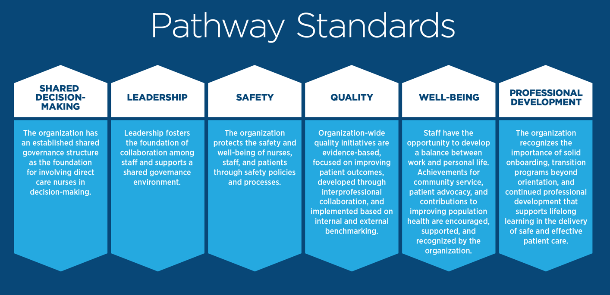

Slide 7

How Pathway to Excellence in LTC can help…
Decrease RN Turnover
Decrease RN Vacancy Rate
Increase RN Retention Rate
Decrease LPN Turnover
Decrease CNA Turnover
Decrease CNA Vacancy Rate
Increase CNA Retention Rate
Increase in Job Satisfaction
Increase in Resident Satisfaction
Better Resident Experience
¹⁴ANA, 2020

Slide 8
RETURNS ON INVESTMENT INCLUDE
Nursing Staff | burnout, job dissatisfaction, and intent to leave | Is lower with: Better work environments^{9,10} Higher engagement in shared governance⁸
 | nurse report of poor quality of care and resident safety | Is lower with: Higher engagement in shared governance¹¹
 | Turnover | 10% reduction in turnover can save 3% of total annual operating costs¹²
Resident | Resident experience | Is better with: Lower nurse burnout and job dissatisfaction^{9,10} Better work environments⁹ Higher engagement in shared governance¹¹
 | Willingness to recommend care center | Higher engagement in shared governance¹¹ Increase in word-of-mouth referrals after PTE designation¹⁴
 | Negative resident outcomes | Are lower with: Better work environments⁹ Decreased rehospitalizations¹⁴
 | Satisfaction | Increases in resident satisfaction after implementation¹⁴
Facility | 5-star rating | Is better with: Higher engagement in shared governance¹¹
⁹Aiken et al., 2012; ¹⁰McHugh et al., 2011; ¹¹Kutney-Lee et al., 2016; ¹²Mukamel et al., 2009 ; ¹³Lake et al., 2019; ¹⁴ANA, 2020

Slide 9

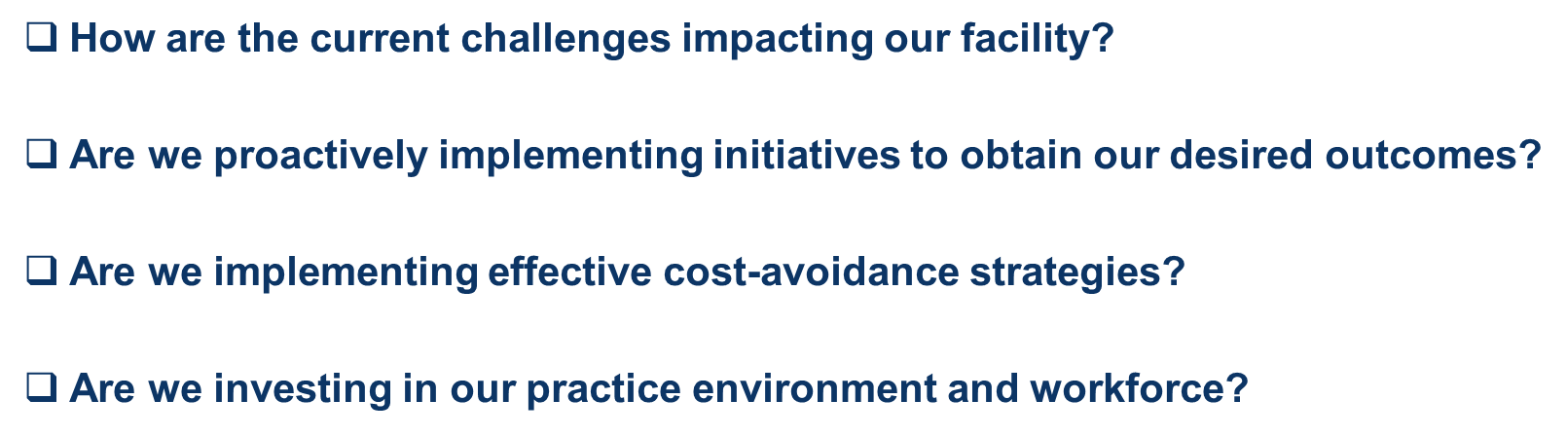
How does our facility compare to the Pathway framework?

Slide 10
ROI: Cost Avoidance
FALL REDUCTION This table can be used to demonstrate potential/actual avoidable costs by using organization’s current data. The template may be edited to demonstrate savings for other NSIs.
FY YEAR | ACTUAL # OF FALLS | AVOIDED # OF FALLS | COST PER FALL | COST AVOIDANCE | ACTUAL COST
FY20 (for example) | 200 | 0 | Falls cost an estimated $6200 per resident per year for SNFs¹⁵ | $0 | $1,240,000
FY21 (for example) | 100 | 50 | $6200 | $310,000 | $620,000
FY 22
FY 23
FY 24
.
¹⁵Carroll et al., 2008

Slide 11
ROI: Cost Avoidance
NURSE TURNOVER This table can be used to demonstrate potential/actual avoidable costs by using organization’s current data.
FY YEAR | ACTUAL INCIDENTS OF NURSE TURNOVER | AVOIDED INCIDENTS OF NURSE TURNOVER | COST PER NURSE TURNOVER | COST AVOIDANCE | ACTUAL COST
FY20 (for example) | 20 (baseline) | 0 | $33,000 to $56,000 Nurse Turnover¹⁶ | $0 | $960,000
FY21 (for example) | 10 | 5 | $48,000 | $240,000 | $480,000
FY 22
FY 23
FY 24
¹⁶NSI Nursing Solutions, 2020

Slide 12
ROI: Cost Avoidance
CNA TURNOVER This table can be used to demonstrate potential/actual avoidable costs by using organization’s current data.
FY YEAR | ACTUAL INCIDENTS OF NURSE TURNOVER | AVOIDED INCIDENTS OF NURSE TURNOVER | COST PER NURSE TURNOVER | COST AVOIDANCE | ACTUAL COST
FY20 (for example) | 20 (baseline) | 0 | $2,200+ (direct cost only)⁴ | $0 | $44,000+
FY21 (for example) | 10 | 5 | $2,200+ (direct cost only) | $11,000+ | $22,000+
FY 22
FY 23
FY 24
¹⁶NSI Nursing Solutions, 2020
⁴Boushy & Glynn, 2012

Slide 13
ROI: Cost Avoidance
REHOSPITALIZATION RATES This table can be used to demonstrate potential/actual avoidable costs by using organization’s current data. The template may be edited to demonstrate savings for other NSIs.
Our facility’s FY YEAR | ACTUAL RATE | AVOIDED RE-HOSPITALIZATIONS | COST PER RE-HOSPITALIZATION | COST AVOIDANCE | ACTUAL COST
FY 2020 (example)
FY A
FY B
FY C
FY D
CMS gives 1.6% more per Medicare patient for reduced rehospitalizations; 2% per patient cut ¹⁷
9 Schimert et al., 2016
¹⁷Rau, 2019

Slide 14
ROI: Cost Avoidance
STAFF INJURY This table can be used to demonstrate potential/actual avoidable costs by using organization’s current data.
FY YEAR | ACTUAL INCIDENTS OF STAFF INJURY | AVOIDED INCIDENTS OF STAFF INJURY | COST PER INJURY | COST AVOIDANCE | ACTUAL COST
FY20 (for example) | 20 | 0 | Up to $7,000¹⁸ | $0 | $140,000
FY21 (for example) | 20 | 10 | $5,000 | $50,000 | $100,000
FY 22
FY 23
FY 24
¹⁸Farris, 2008

Slide 15

Our frontline is our bottom line!
Engagement of LTC Facility Name’s employees is key to our success
Success is when resident safety and other facility outcomes are owned and become the responsibility of every single employee.
Registered nurses follow physicians as the least engaged of the healthcare workforce¹⁹
¹⁹Press Ganey 2019

Slide 16
Is the Pathway framework Right Fit for our facility?
Is creating a positive practice environment aligned with your facility’s mission and vision?
Does it address your challenges?
Will it help achieve your strategic objectives and desired outcomes?
Is investing in the workforce a priority for the facility?
Is creating an environment that nursing staff and other clinicians can call their professional home desired by the organization?
Does the facility recognize the importance of safeguarding staff well-being?
Is the international recognition desired by the facility?

Slide 17
How can Pathway LTC designation benefit our facility?
 |  | Our desired state
Staff Outcomes | Employee Engagement
 | Staff Satisfaction
 | Intent to Leave
Resident Outcomes | Facility experience / Overall satisfaction
 | Loyalty or willingness to recommend hospital
 | Staff Sensitive Indicators
Facility Outcomes | Hospital rating / recognition
 | Employee turnover rate
 | Employee vacancies

Slide 18
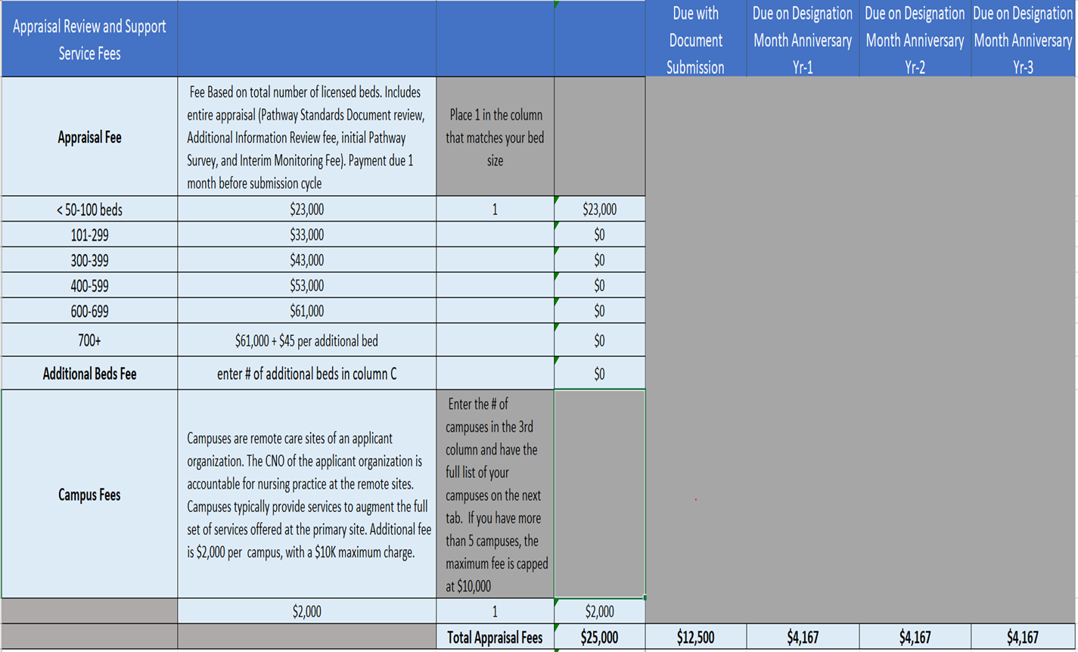
Costs of Becoming a Pathway LTC Facility
Access the Pathway Fee Calculator by clicking on https://www.nursingworld.org/organizational-programs/pathway/apply/fees/fee-calculator-form/
**Fees are subject to change**

Slide 19


Discussion and
Questions

Slide 20
References
US Department of Health and Human Services. (2016). Long-term Care Providers and Services Users in the United States. National Center for Health Statistics: Vital and Health Statistics. Retrieved from Vital and Health Statistics, Series 3, Number 43 (cdc.gov)
Grabowski, D. C., Aschbrenner, K. A., Rome, V. F., & Bartels, S. J. (2010). Review: Quality of Mental Health Care for Nursing Home Residents: A Literature Review. Medical Care Research and Review, 67(6), 627-656. doi:10.1177/1077558710362538
White, E. M., Aiken, L. H., & McHugh, M. D. (2019). Registered nurse burnout, job dissatisfaction, and missed care in nursing homes. Journal of the American Geriatrics Society, 67(10), 2065-2071.
Boushey, H., & Glynn, S. J. (2012). There are significant business costs to replacing employees. Center for American Progress, 16, 1-9.
Salela, A. (2017). LTC worker shortage a 'train wreck waiting to happen,' expert says. Retrieved from https://www.mcknights.com/news/ltc-worker-shortage-a-train-wreck-waiting-to-happen-expert-says/

Slide 21
References, cont.
6. Ross, J. (2018). Alarming trend in LTC: Overtime up 60% in 3 Years. Retrieved from https://www.mcknights.com/marketplace/
7. Castle, N. G., & Ferguson-Rome, J. C. (2014). Influence of Nurse Aide Absenteeism on Nursing Home Quality. The Gerontologist, 55(4), 605-615. doi:10.1093/geront/gnt167
8. White, E., Woodford, E., Britton, J., Newberry, L., & Pabico, C. (2020). Nursing practice environment and care quality in nursing homes. Nursing Management, 51(6), 9-12. doi:10.1097/01.NUMA.0000662656.07901.a8
9. Aiken LH, Sermeus W, Van den Heede K, Sloane DM, Busse R, et al. (2012). Patient safety, satisfaction, and quality of hospital care: cross sectional surveys of nurses and residents in 12 countries in Europe and the United States. BMJ. 344:e1717.
10. McHugh MD, Kutney-Lee A, Cimiotti JP, Sloane DM, Aiken LH. (2011). Nurses’ widespread job dissatisfaction, burnout, and frustration with health benefits signal problems for resident care. Health Affairs. 30(2):202-210.

Slide 22
References, cont.
11. Kutney-Lee A, Germack H, Hatfield L, Kelly S., Maguire P, et al. (2016). Nurse engagement in shared governance and resident and nurse outcomes. J Nurs Admin. 46(11):605-612.
12. Mukamel, D. B., Spector, W. D., Limcangco, R., Wang, Y., Feng, Z., & Mor, V. (2009). The Costs of Turnover in Nursing Homes. Medical Care, 47(10), 1039-1045. doi:10.1097/mlr.0b013e3181a3cc62
13. Lake ET, Sanders J, Duan R, Riman KA, Schoenauer KM, Chen Y. (2019). A Meta-Analysis of the Associations Between the Nurse Work Environment in Hospitals and 4 Sets of Outcomes. Med Care. 57(5):353-361. doi: 10.1097/MLR.0000000000001109.
14. American Nurses Association. (2020). Testimonials and Case Studies. Retrieved from https://www.nursingworld.org//pathway/overview/
Carroll, N. V., Delafuente, J. C., Cox, F. M., & Narayanan, S. (2008). Fall- Related Hospitalization and Facility Costs Among Residents of Institutions Providing Long-Term Care. The Gerontologist, 48(2), 213-222. doi:10.1093/geront/48.2.213

Slide 23
References, cont.
NSI Nursing Solutions, Inc. (2020). National Healthcare Retention & RN Staffing Report; 2020. Accessed 07/17/20 at https://www.nsinursingsolutions.com/Documents/Library/NSI
Rau, J. (2019). Medicare Cuts Payments To Nursing Homes Whose Patients Keep Ending Up In Hospital. Retrieved from https://khn.org/news/medicare-cuts-payments-to-nursing-homes-whose- patients-keep-ending-up-in-hospital/
Faris J. (2008). Lowering nursing injuries using post offer pre-employment testing. Work, 31(1), 39–45.
Press Ganey. (2019). Health Care Workforce Special Report: The State of Engagement (White Paper). Accessed 07/17/20 at https://www.pressganey.com/blog/press-ganey-releases-special-report-on- state-of-health-care-workforce-engagement

Slide 24
Learn More
PATHWAY DESIGNATION
https://www.nursingworld.org/organizational-programs/pathway/
90-SECOND VIDEO OVERVIEW TO INTRODUCE NURSES TO
PATHWAY TO EXCELLENCE
https://youtu.be/aX8vH9F-3Sg?list=PLCGdz-zkJ3hpwG9461zb4UAXPX2IZnv9f
LONG TERM CARE RESOURCES
https://www.nursingworld.org/organizational-programs/pathway/overview/pathway-to-excellence-in-long-term-care/
CASE STUDIES
https://www.nursingworld.org/organizational-programs/pathway/overview/testimonials-and-case-studies/
PATHWAY TO EXCELLENCE PUBLICATIONS
https://www.nursingworld.org/continuing-education/ce-subcategories/pathway/
A LITERATURE TABLE OF SELECTED RESEARCH STUDIES THAT HIGHLIGHT A FAVORABLE ASSOCIATION BETWEEN A VARIABLE WE INTERPRET TO BE CONSISTENT WITH A PATHWAY TO EXCELLENCE CHARACTERISTIC AND PATIENT, NURSE, OR ORGANIZATIONAL OUTCOMES
https://www.nursingworld.org/organizational-programs/pathway/library-of-pathway-associated-concepts/
Learn more

