Slide 1

Dear colleague,
The following slides are resources that can be incorporated into your existing professional development programming, town halls, nursing grand rounds, residency program, or anywhere appropriate for your organization and can be customized and adapted to align with your organization’s existing programming. Using these slides and the accompanying “Getting on Board” and “Making the Case” and will be an aid in bringing the conversation about nurses on boards to your organization in a way that fits with your organization’s culture, values, and strategic plan.

Slide 2
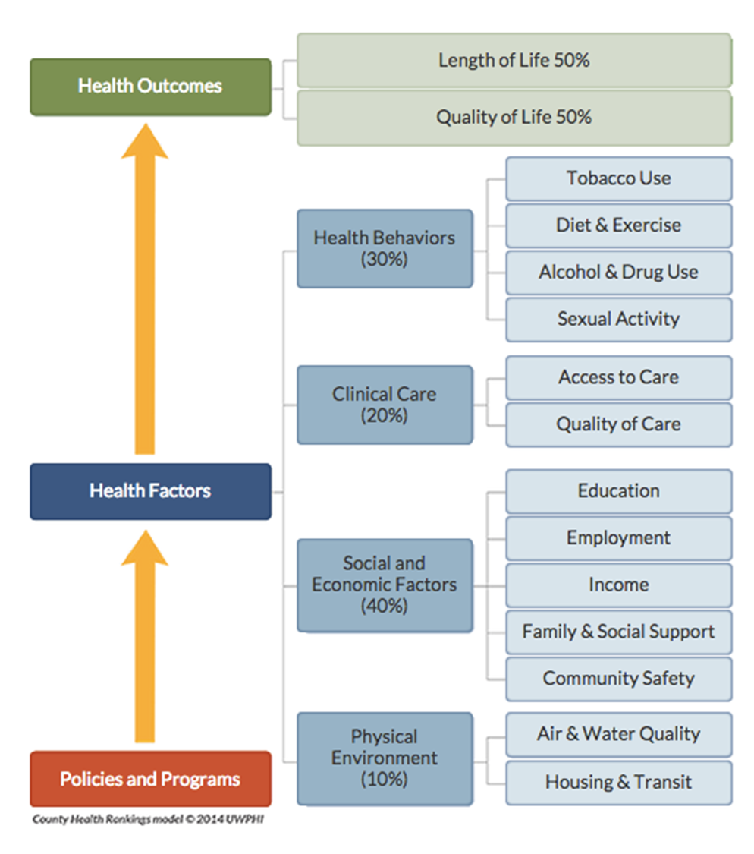
Health beyond healthcare
Your logo here
Notes:
As you’ve seen in your practice, health is about more than what happens in a clinical setting. It’s about clean air and water, safe places to live and play, affordable housing, healthy food and so much more.
All of these factors are the social determinants of health. Looking at this, there are so many ways that nurses can influence health. They represent opportunities outside of traditional healthcare settings where we can have an impact.

Slide 3

“Without a nurse trustee, boards lack an authority on the patient experience, quality and safety and the largest part of the hospital workforce.”
–Charlotte Huff, Trustee
Your logo here
Notes:
As Charlotte Huff said in Trustee, the leading publication for health care board members, “Without a nurse trustee, boards lack an authority on the patient experience, quality and safety and the largest part of the hospital workforce.”
While Charlotte is referring specifically to hospital boards, I want to us now to think outside of the hospital. We’re here at work, so you may wonder why I say this. It’s because I know we are nurses regardless of where we are.
And it is with this in mind that I am sharing the work about nurses taking roles on boards of directors.
The board of directors can be both inside and outside of healthcare, from local community boards, to multi-billion dollar corporations. Regardless of the industry, a nurse can have an impact in any boardroom.

Slide 4

Why this matters
Participating in the national movement
3.8 million registered nurses nationwide
5% of hospital board seats filled by nurses
1.5 million non-profits nationwide
Your logo here
Notes:
I think everyone here agrees that nurses serving on boards is fundamentally a good thing. But before we dive into all that we as nurses have to offer, I want us to think about why.
There is a national movement underway which is built on the Institute of Medicine’s 2010 landmark report on the Future of Nursing which included a recommendation for increasing the number of nurses in leadership roles. And this call for leadership includes serving on boards, commissions and task forces.
As part of the report, it sates “Yet their history as a profession dominated by females can make it easier for policy makers, other health professionals, and the public to view nurses as ‘functional doers’—those who carry out the instructions of others—rather than ‘thoughtful strategists’—those who are informed decision makers and whose independent actions are based on education, evidence, and experience.”
We can change this!
This effort is driven by each of us, the 3.8 million RNs around the country. As I’ve already said, we make up the largest proportion of the healthcare work force. And we have skills and a unique perspective that we can bring to the boardroom.
Right now we don’t actually know how many nurses are serving on board across the country. We know that according to American Hospital Association’s National Health Care Governance Survey, only 5% of total board seats of hospitals are held by nurses. By comparison, physicians make up 20%. T
Despite this huge underrepresentation, we know there is interest and opportunity. Hospital boards are just one small segment of the leadership opportunities nationwide. For example, there are over 1.5 million non-profit organizations.
There are over 6,000 nurses who have stepped up through the Nurses on Boards Coalition and indicated their interest in serving on a board.
And we have the opportunity to bring this work here, and I am calling on each of us, to think about the role you can play.

Slide 5

Our nurses possess a special set of skills
Leadership
Quality & process improvement
Communications
Human resources
Strategic planning
Finance
Teamwork
…and many others
Your logo here
Notes:
When I think of the skills that our nurses have here, I know this list barely begins to cover it.
ALSO – this list doesn’t include honesty, which for the 16th consecutive years, nurses were named the most honest and ethical profession in America in a Gallup poll.
With all of this in mind, I am encouraging our entire nursing staff to think about how board service could fit in your development as a nurse and a leader.
How many nurses here currently serve, or have served, on a board? The PTA board, local non-profit, community board? Whether or not you thought consciously about it, I bet you brought your nursing experience to the table.
[insert personal story if applicable]
Now just imagine the impact our nursing staff could have if we all served on a board in our community?

Slide 6

What’s In it for YOU?
Expand your leadership
Be a player—not just an observer
Lead change
Expand the public’s understanding of nurses’ roles
Advance the profession
Compensation
Certifications and credentialing
Your logo here
Notes:
I just outlined what YOU can do for a board. But it’s a two-way street.
What can board service can do for YOU.
First and foremost, you will LEARN.
You will have opportunities to observe how others lead, well and poorly. You will have a chance to move beyond your current environment.
You will get to practice leadership.
You CAN lead change when you are volunteer leader.
You will expand the public’s understanding of RNs and APRNs’ expertise. You – yourself – will elevate the image of nursing.
You could even get paid – for profit boards pay their board members. IF you are either a content expert and/or have run a successful business you might be a great candidate. It wont be your first board. But the 1st leads to the 2nd. You get ready by doing.
And did you know that your board service can even help you fulfil requirements from your certifications and renewals? Also, it can be reported during our hospital’s redesignation process to meet key standards.

Slide 7
Nurses on boards and [your organization]
Insert text on your values
Insert text on your professional programs
Insert text on your organizations journey towards nursing excellence
Your logo here
Notes:
Use this slide to talk specifically about how this work can align within your organization.
This can include how the work aligns with your organization’s values, existing programs. Mention any personal stories of the nurses on your staff etc.
Make this your own.

Slide 8
Getting on board
Start with YOUR personal passion
Consider your professional nursing association or other groups
Google leadership & volunteer opportunities in their area
Express interest
Join a committee at work
Build you personal board competencies
Your logo here
Notes:
I know some of you may think this sounds like a good idea, but where would I even begin?
Try these 11 tips:
Start with your passion – where do you commit your time? Your money?
What groups, including professional nursing organizations are you a member of? These organizations often run on small, or volunteer, staffs and thrive when volunteers step up as committee members, volunteers, and board members.
Broaden your search using tools like Volunteer Match and LinkedIn
Tell you manager that you want to serve on a board
Join a committee here (include examples as relevant)
Look for opportunities to build your competencies. As an honest profession, we often feel that we have to be experts in order to be qualified to serve on a board. It is more important to be willing and eager to learn.

Slide 9
Getting on board
7. Develop a Board/Volunteer Resume
8. Don’t let your calendar dissuade you
9. You don’t have to be wealthy to be a board member
10. Use the Getting on Board as a resource
11. Sign up at www.nursesonboardscoalition.org
Your logo here
Notes:
Develop a board resume – The Getting on Board document has a link to a webinar to get you started.
Don’t let your calendar dissuade you. When you’re looking at opportunities ask about the time commitment, you might be surprised.
Many people assume to be a board member you need to write a significant check. This is not the case, and is continuing to change even more. Like the time commitment, have an open conversation. Many boards will make arrangements especially if your skills are in high demand.
The American Nurses Foundation has provided Getting on Board – a 1 pager with resources for how you can prepare yourself for board service. Use and adapt it as your own personal road map.
Sign up for the Nurses on Boards Coalition – they are building a national database of nurses who currently serve and want to serve on boards.
These are just some thoughts. The American Nurses Foundation has created a one pager with opportunities to get on boards. It is available to all of you [fill in location on intranet etc.]. Check it out and think about how you can get involved.

